Slide 1
SELF-INTRODUCTION
Zeng Haozhou
School of Mechanical Engineering
Zhejiang University
2024.10.18
Notes:
Prof. Kang

Slide 2
Personal Information
Education
Zhejiang University, School of Mechanical Engineering Hangzhou, China
Academic master of Mechanical Engineering Sep. 2022 – Present
Academic Grade:91.9 (top 3%, Rank 1)
Zhejiang University, School of Mechanical Engineering Hangzhou, China
Major: Bachelor of Mechatronic Engineering Sep. 2018 – Jun. 2022
Minor: Chu Kochen Advanced Honor Class of Engineering Education (top 5%) Sep. 2019 – Jun. 2022
GPA:3.93/4.00 (top 4%), National Scholarship (top 2%)
Research Interests
Human-robot interaction (HRI) and wearable robotics, such as rehabilitation exoskeletons and gait analysis.
Machine learning methods for robot control, such as Bayesian inference and imitation learning.
Notes:
Detailed in the resume
Focus on some of my research works

Slide 3
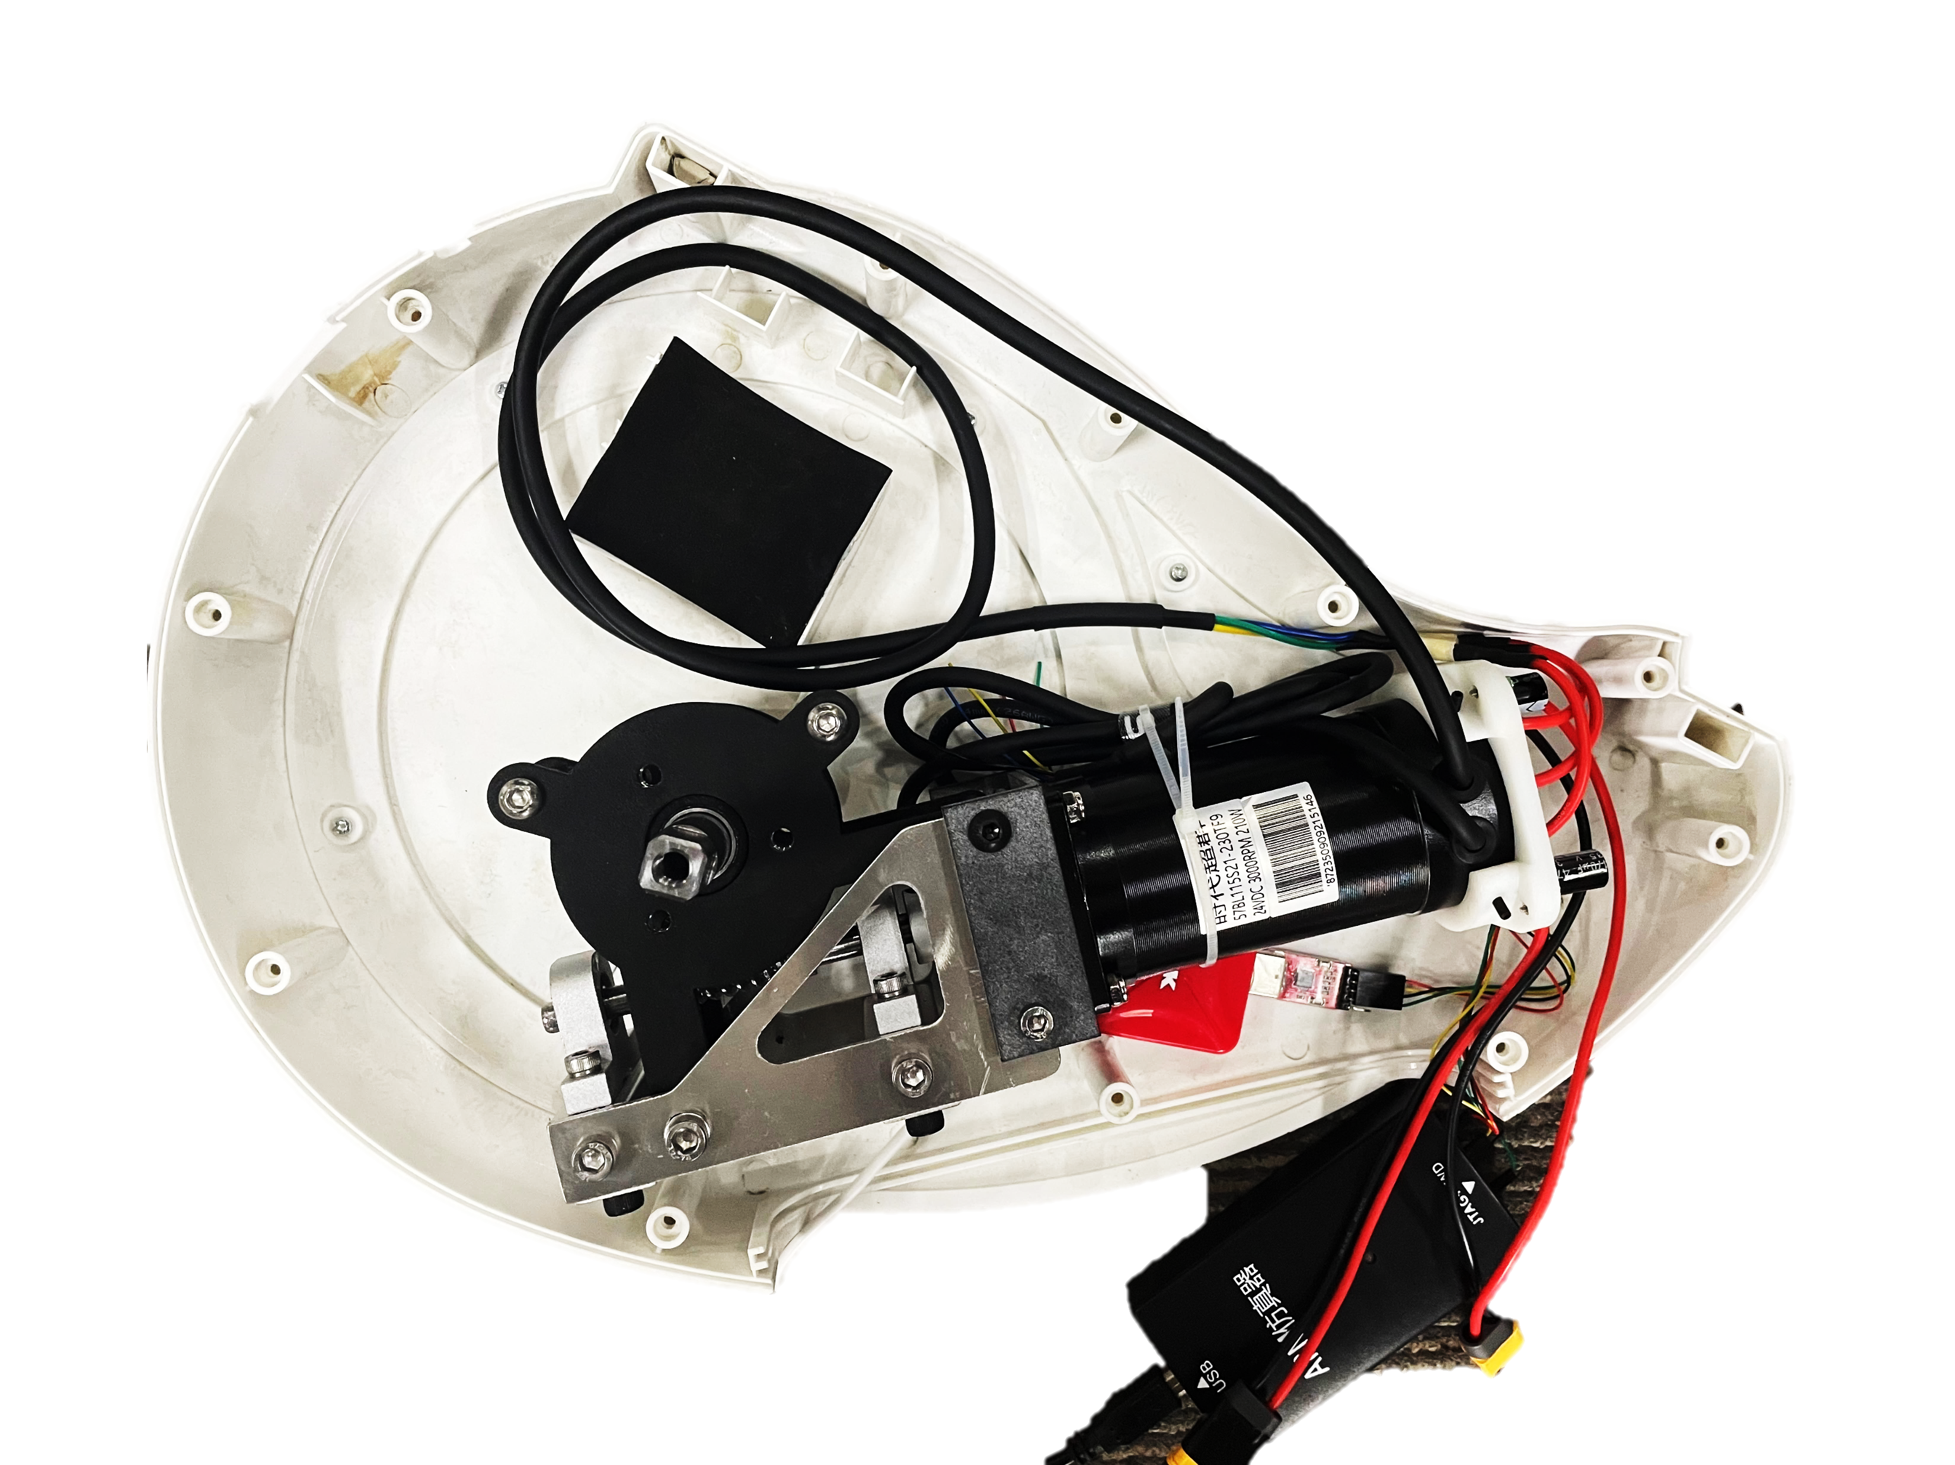
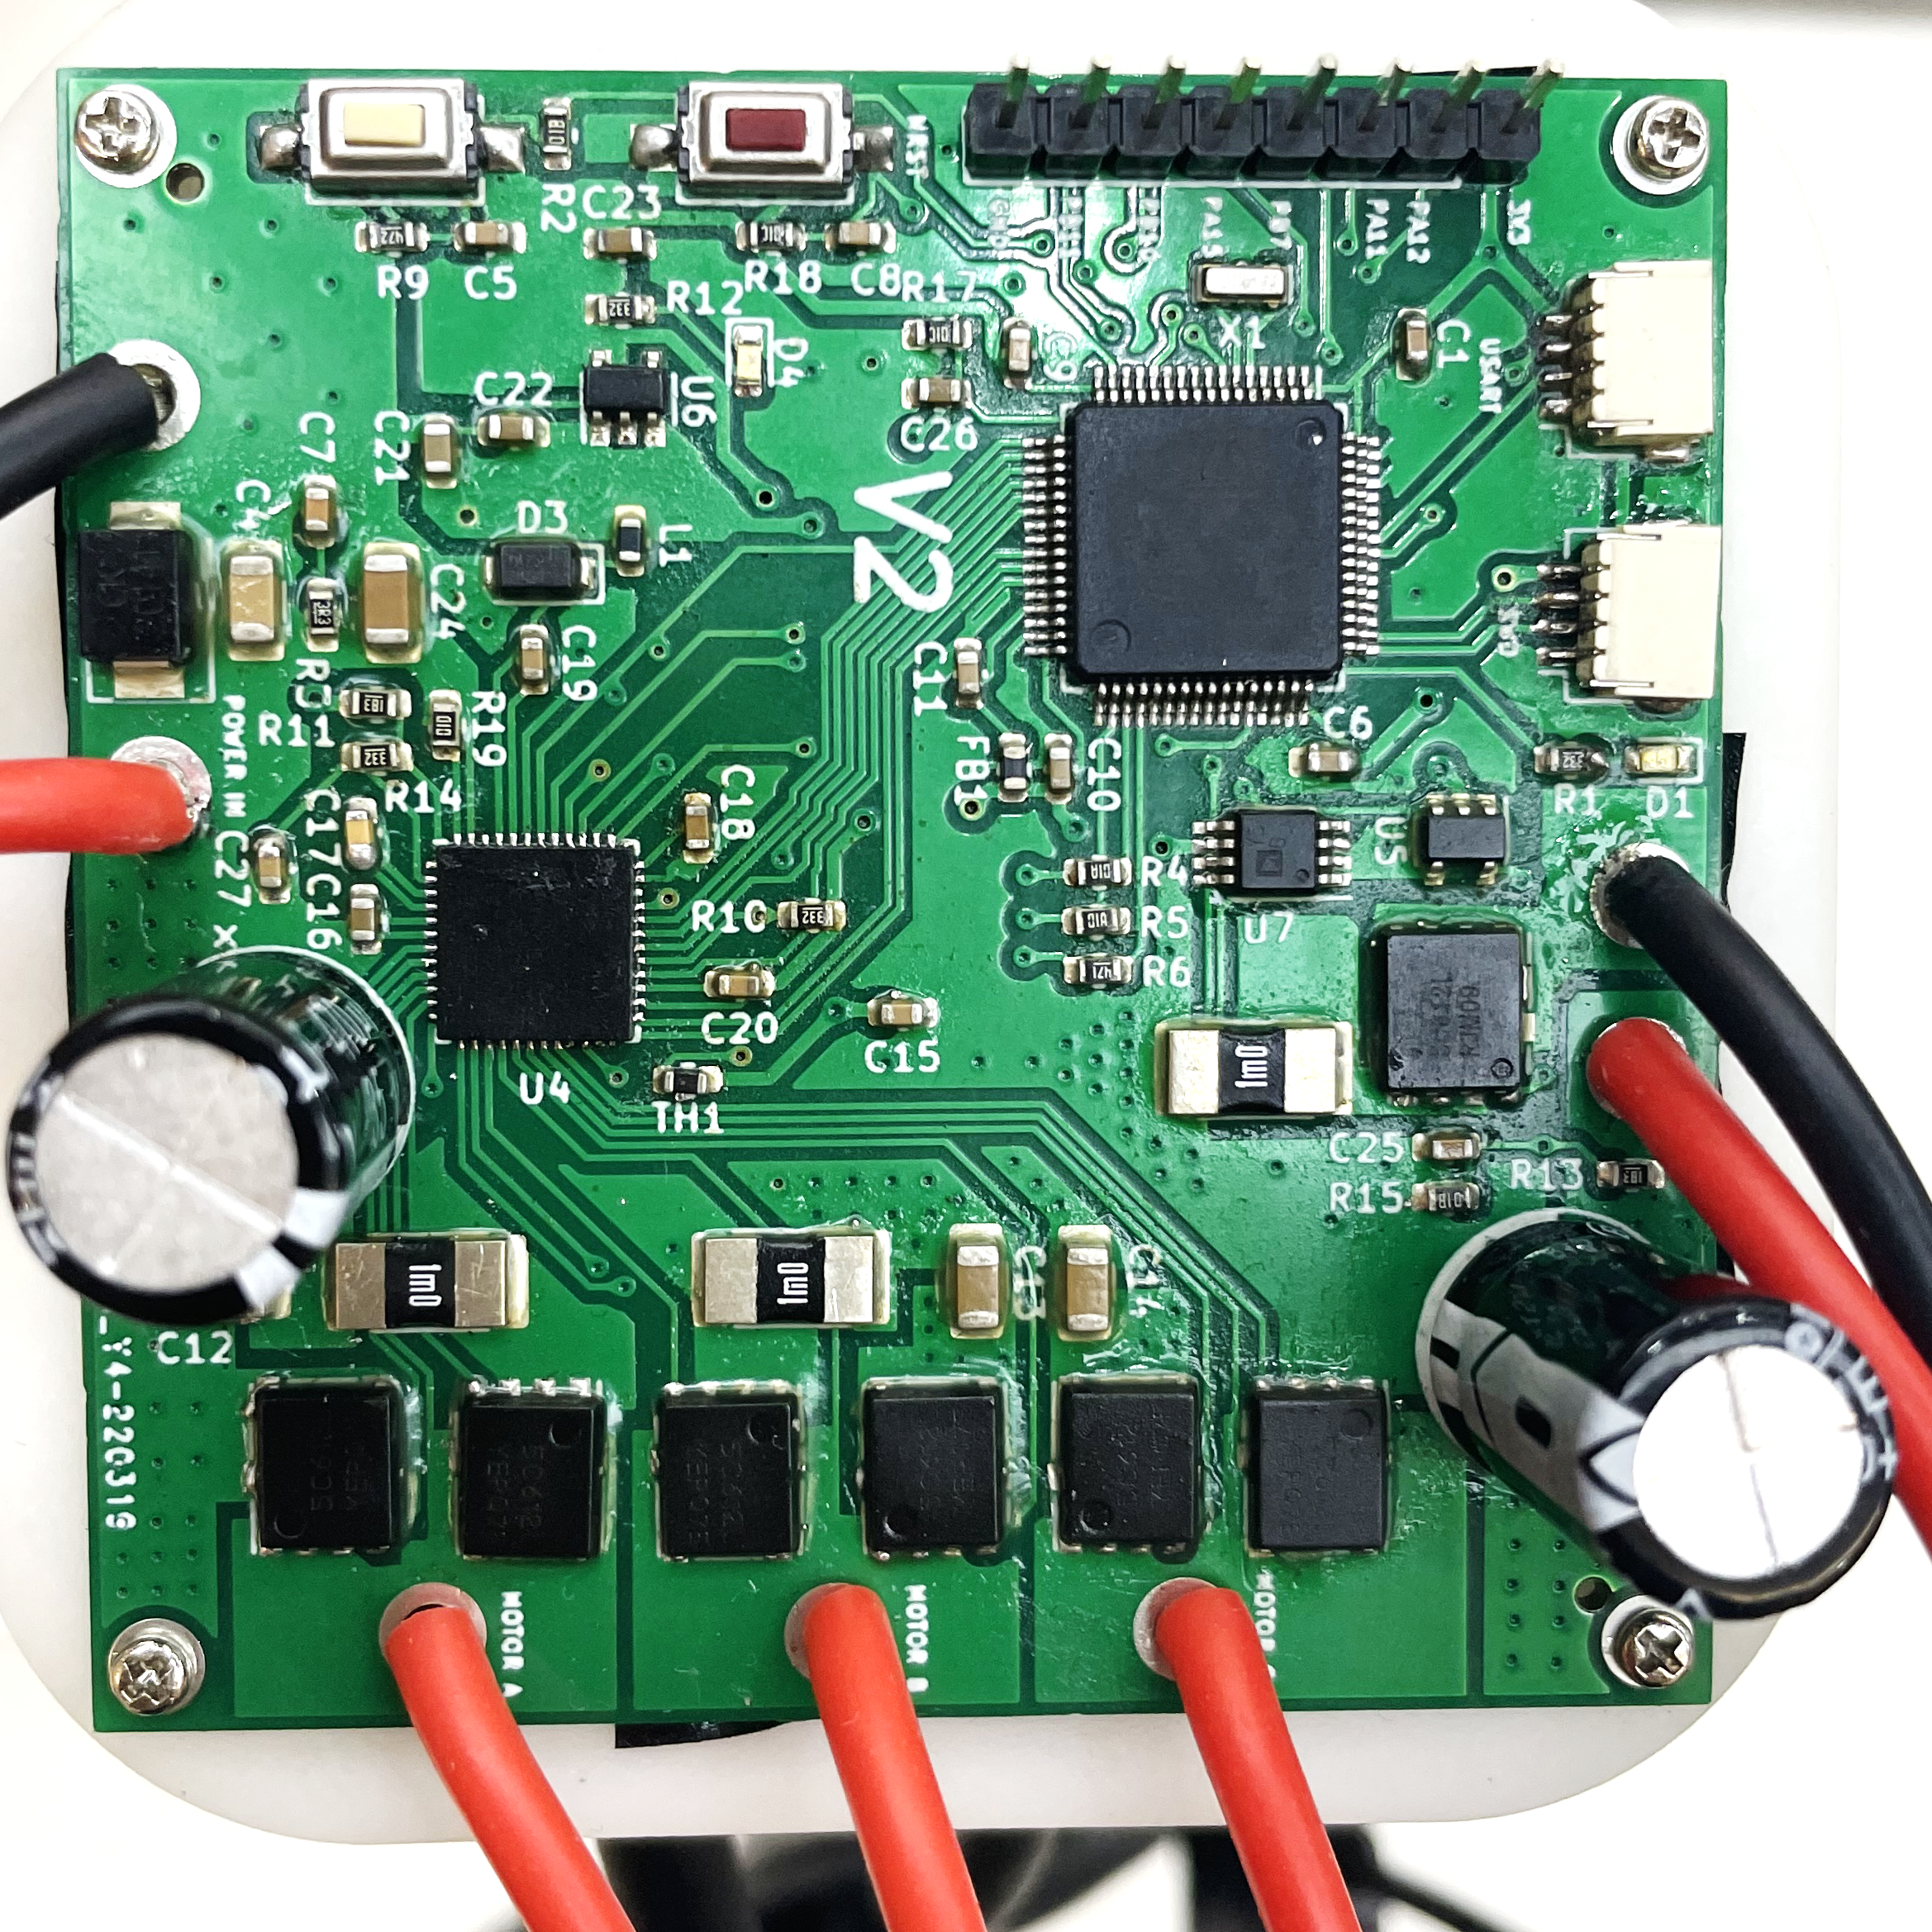
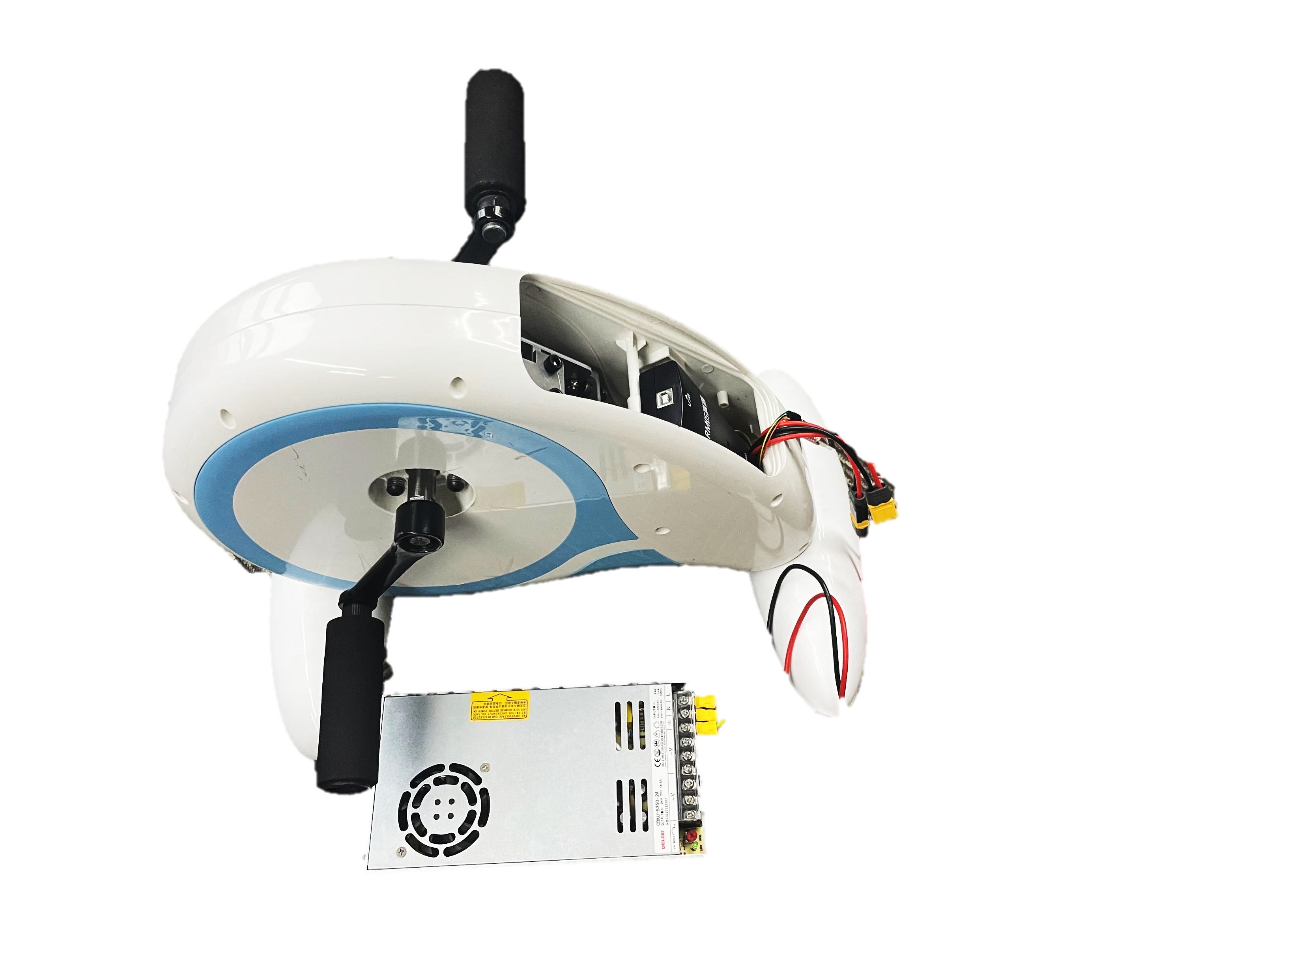
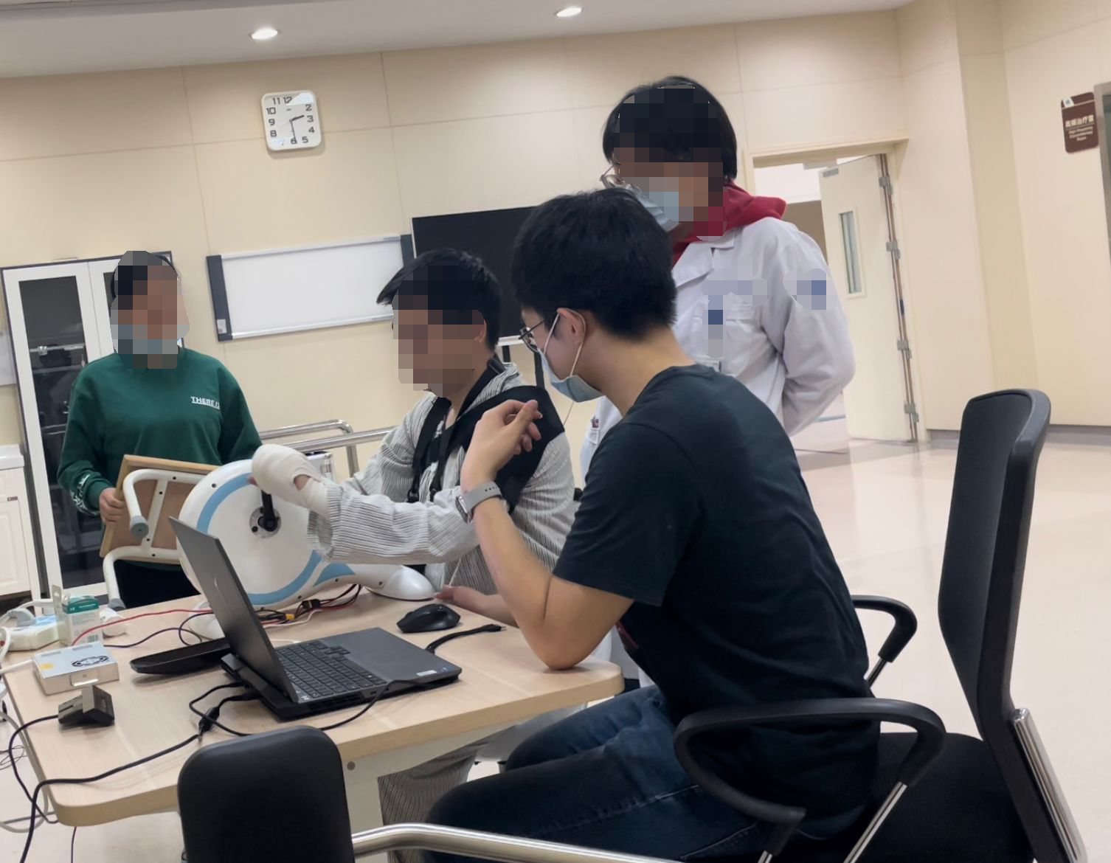
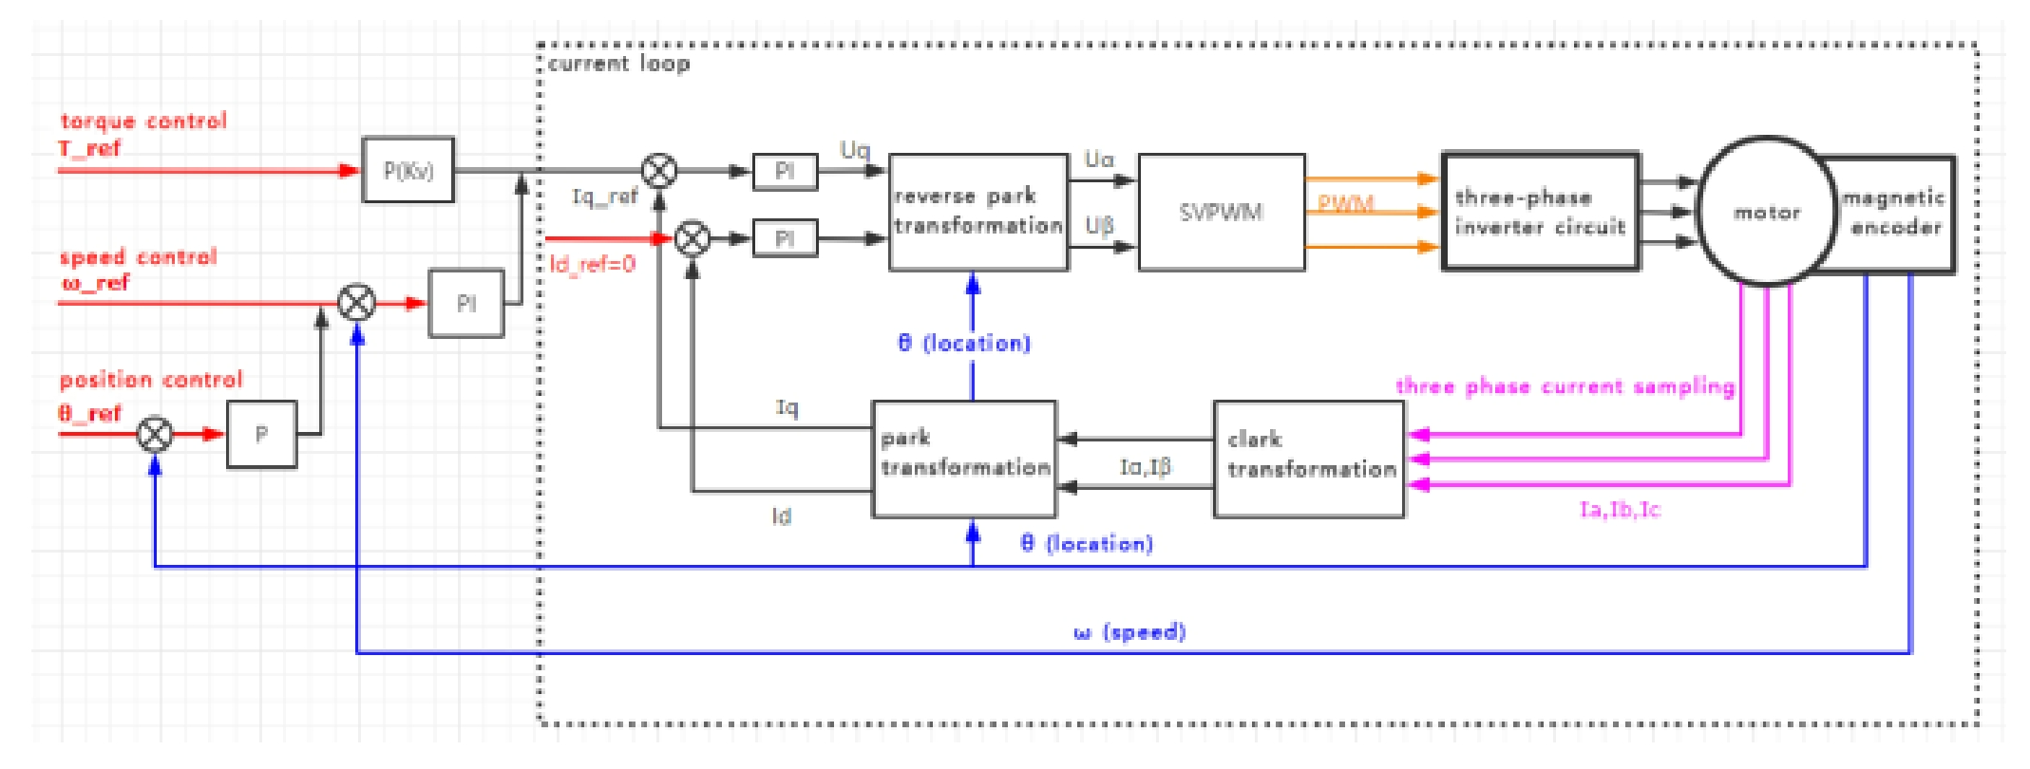
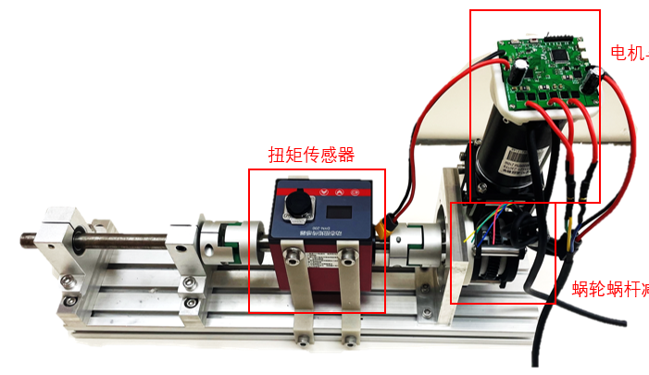
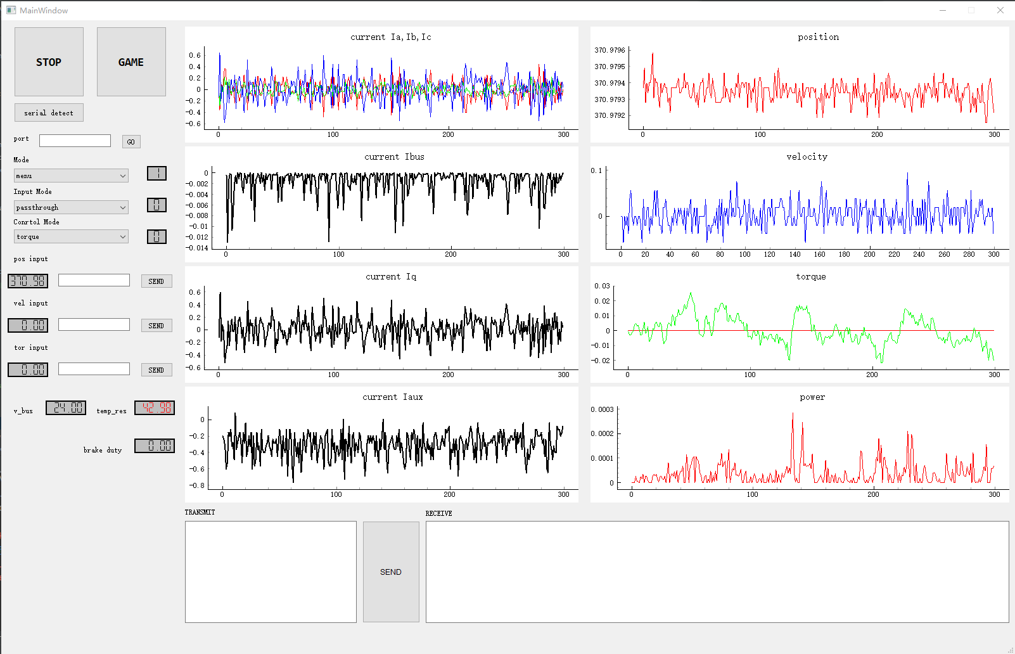
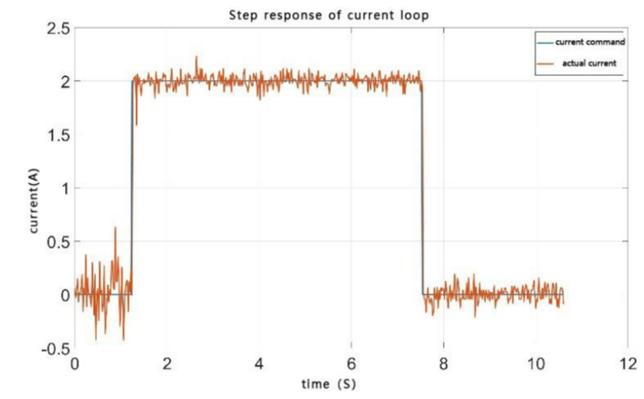
Research Experiences
Voltage (V) | 24
Rated power (W) | 210
Rated torque (Nm) | 18
Rated current (A) | 13
Reduction ratio | 25:1
Design of an upper limb rehabilitation training equipment
Design the control PCB of permanent magnet synchronous motor with the FOC algorithm (STM32, C language).
Test the motor on a test bench and design a prototype.
Rehabilitation experiment based on prototype.
Application
Verification
worm gear reducer
Control Board
Motor control board
motor
Prototype
Clinical Experiment
Test bench for parameter identification
Torque sensor
Control block diagram of FOC
Basic current control
User interface written with Python
Conference paper
Han Y, Zeng H, Fang Z, et al. Motor Drive Design for Upper Limb Rehabilitation Equipment[C]//2022 6th International Conference on Measurement Instrumentation and Electronics (ICMIE). IEEE, 2022: 19-27.
Chinese patent
Liu T, Zeng H, The invention relates to an intelligent upper limb exercise rehabilitation instrument and a method thereof, CN116617046A. 2023.
Notes:
1. The user grab the handle, rotate. Give some resistance.
2. Main work about motor control technology

Slide 4
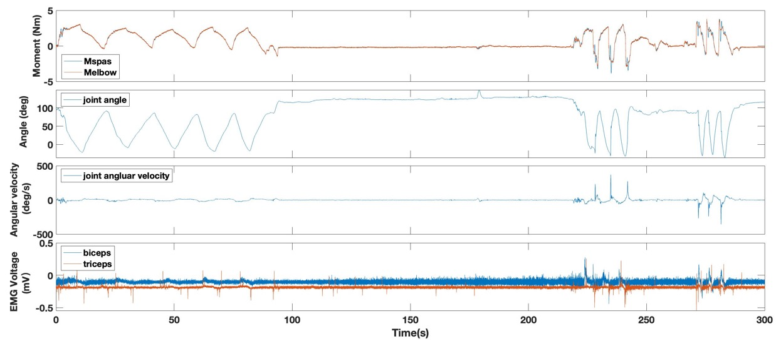
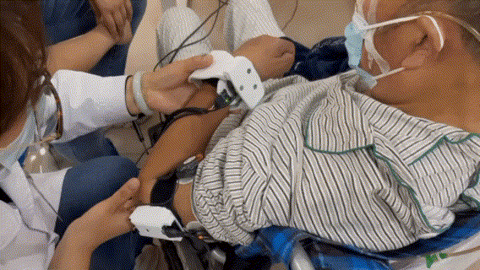
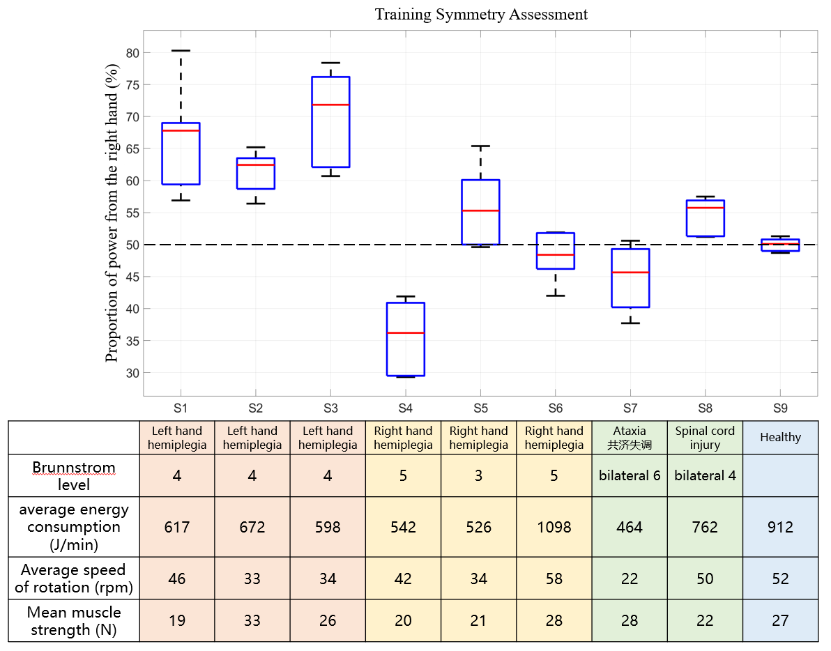
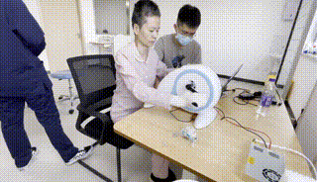
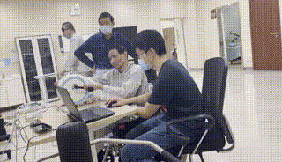
Research Experiences
Design of an upper limb rehabilitation training equipment
Upper limb spasticity characteristic data collection
Collection System:
IMU
Six-axis force sensor
sEMG
Prototype clinical experiments

Slide 5
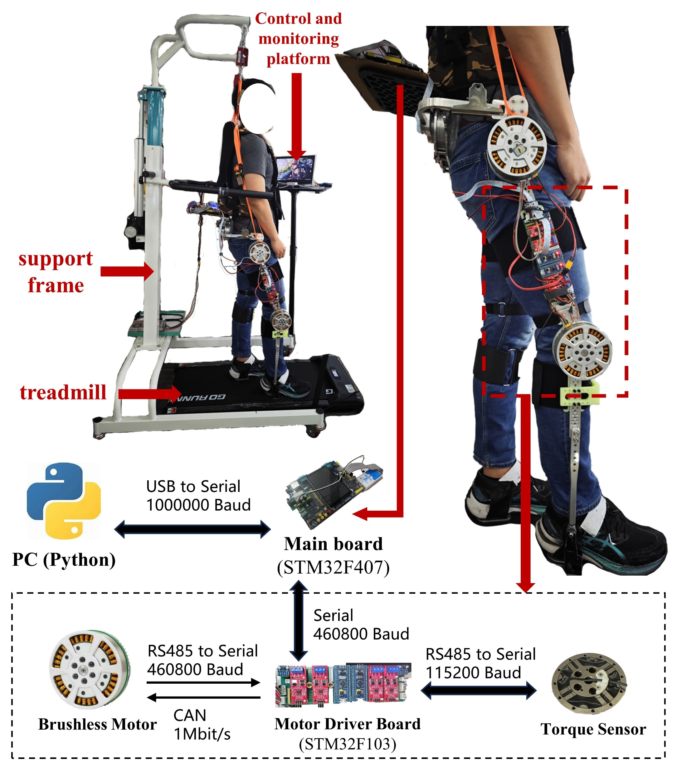
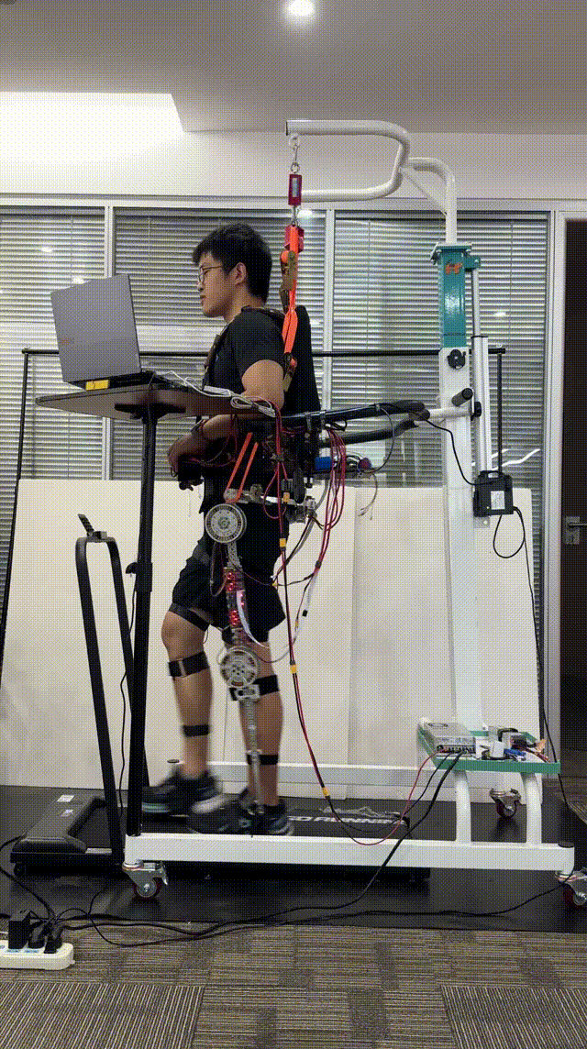
Research Experiences
Design of a lower limb rehabilitation exoskeleton
Motor Characteristics
Voltage (V) | 24
Rated power (W) | 200
Rated torque (Nm) | 90
Peak torque (Nm) | 190
Rated current (A) | 11.5
Peak current (A) | 25
Reduction ratio | 37:1
Communication: CAN, Serial ports, RS485
Control Frequency: 200Hz
STM32 written in C language, RTOS
Notes:
Introduction with the picture
Hip, knee joint, backpack
More powerful motor

Slide 6
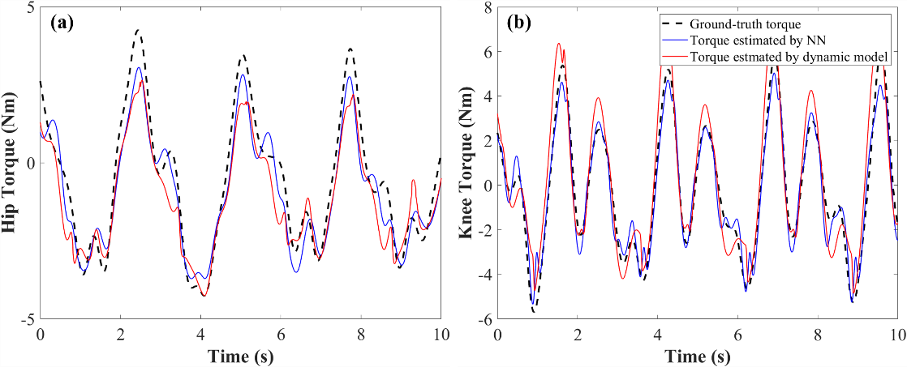
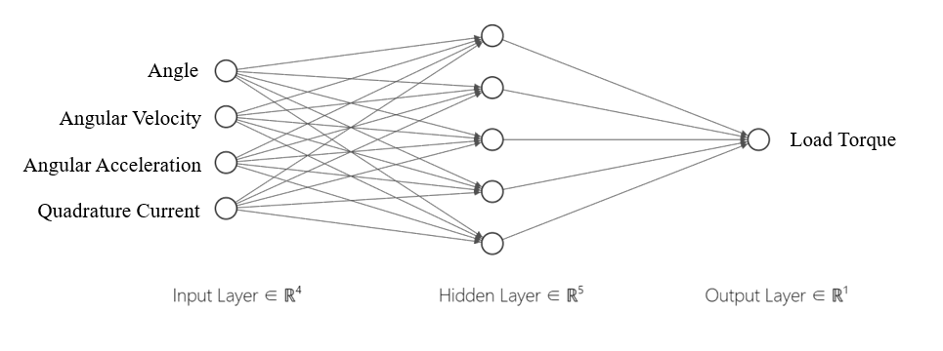
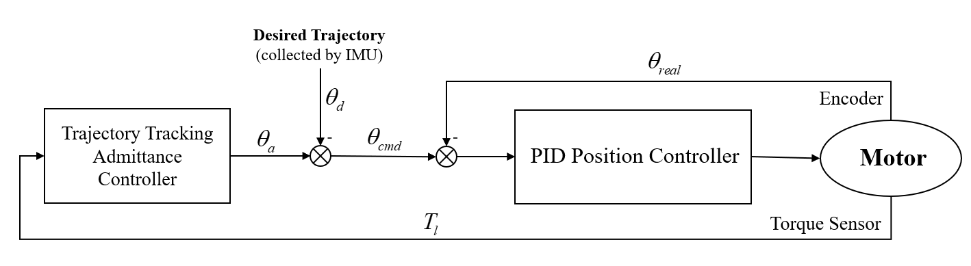
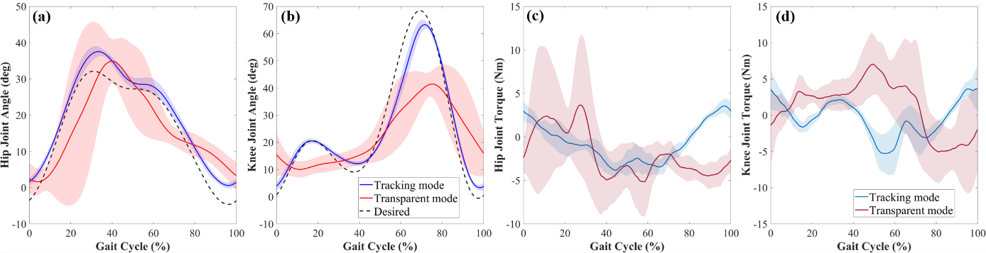
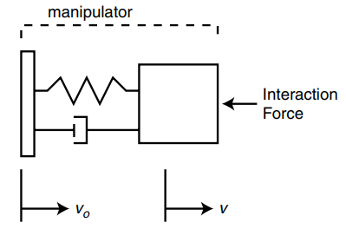
Research Experiences
Torque estimation and compliant control for exoskeletons
Interaction torque estimation with BPNN
$$KI_{q}−T_{env}=J\dot{ω_{m}}+Bω_{m}+f\left(θ_{m},ω_{m},\dot{ω_{m}}\right)$$
Trajectory Tracking Condition & Interaction torque reduction (compared with back-driven condition)
Trajectory Tracking Compliant Controller
2rd-order
spring-mass-damper system
Notes:
1. Torque of the exoskeleton’s link

Slide 7
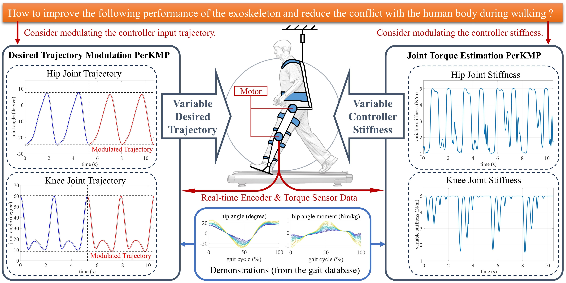
Research Experiences
Real-Time Control and Transparency Enhancement
PerKMP : Periodic Kernelized Movement Primitives

Slide 8
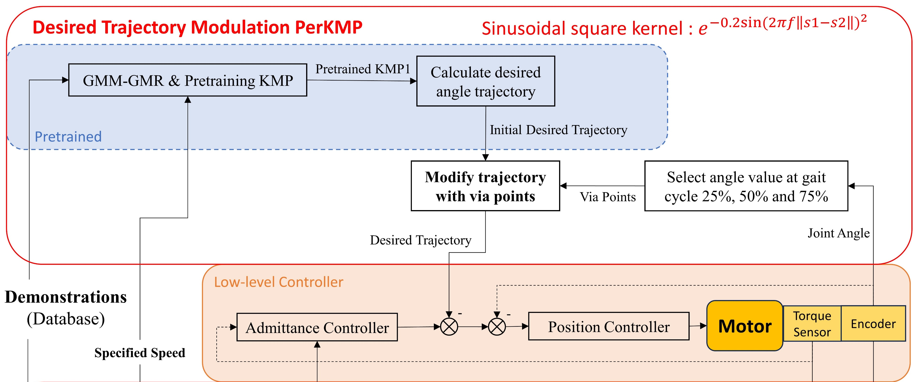
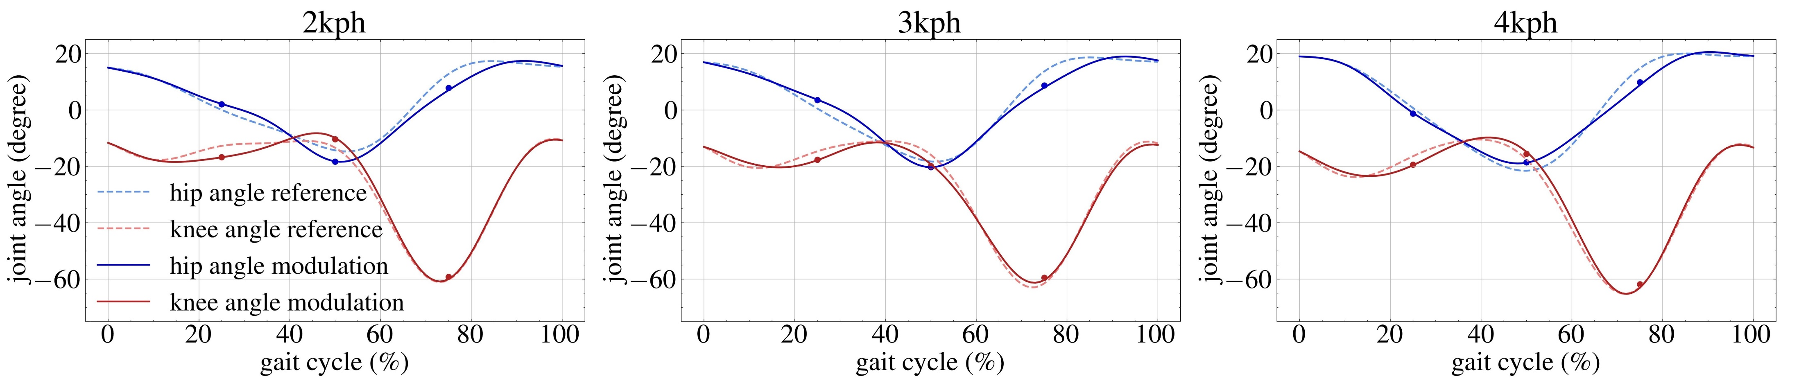
Research Experiences
Design of a lower limb rehabilitation exoskeleton
Real-Time Control and Transparency Enhancement

Slide 9
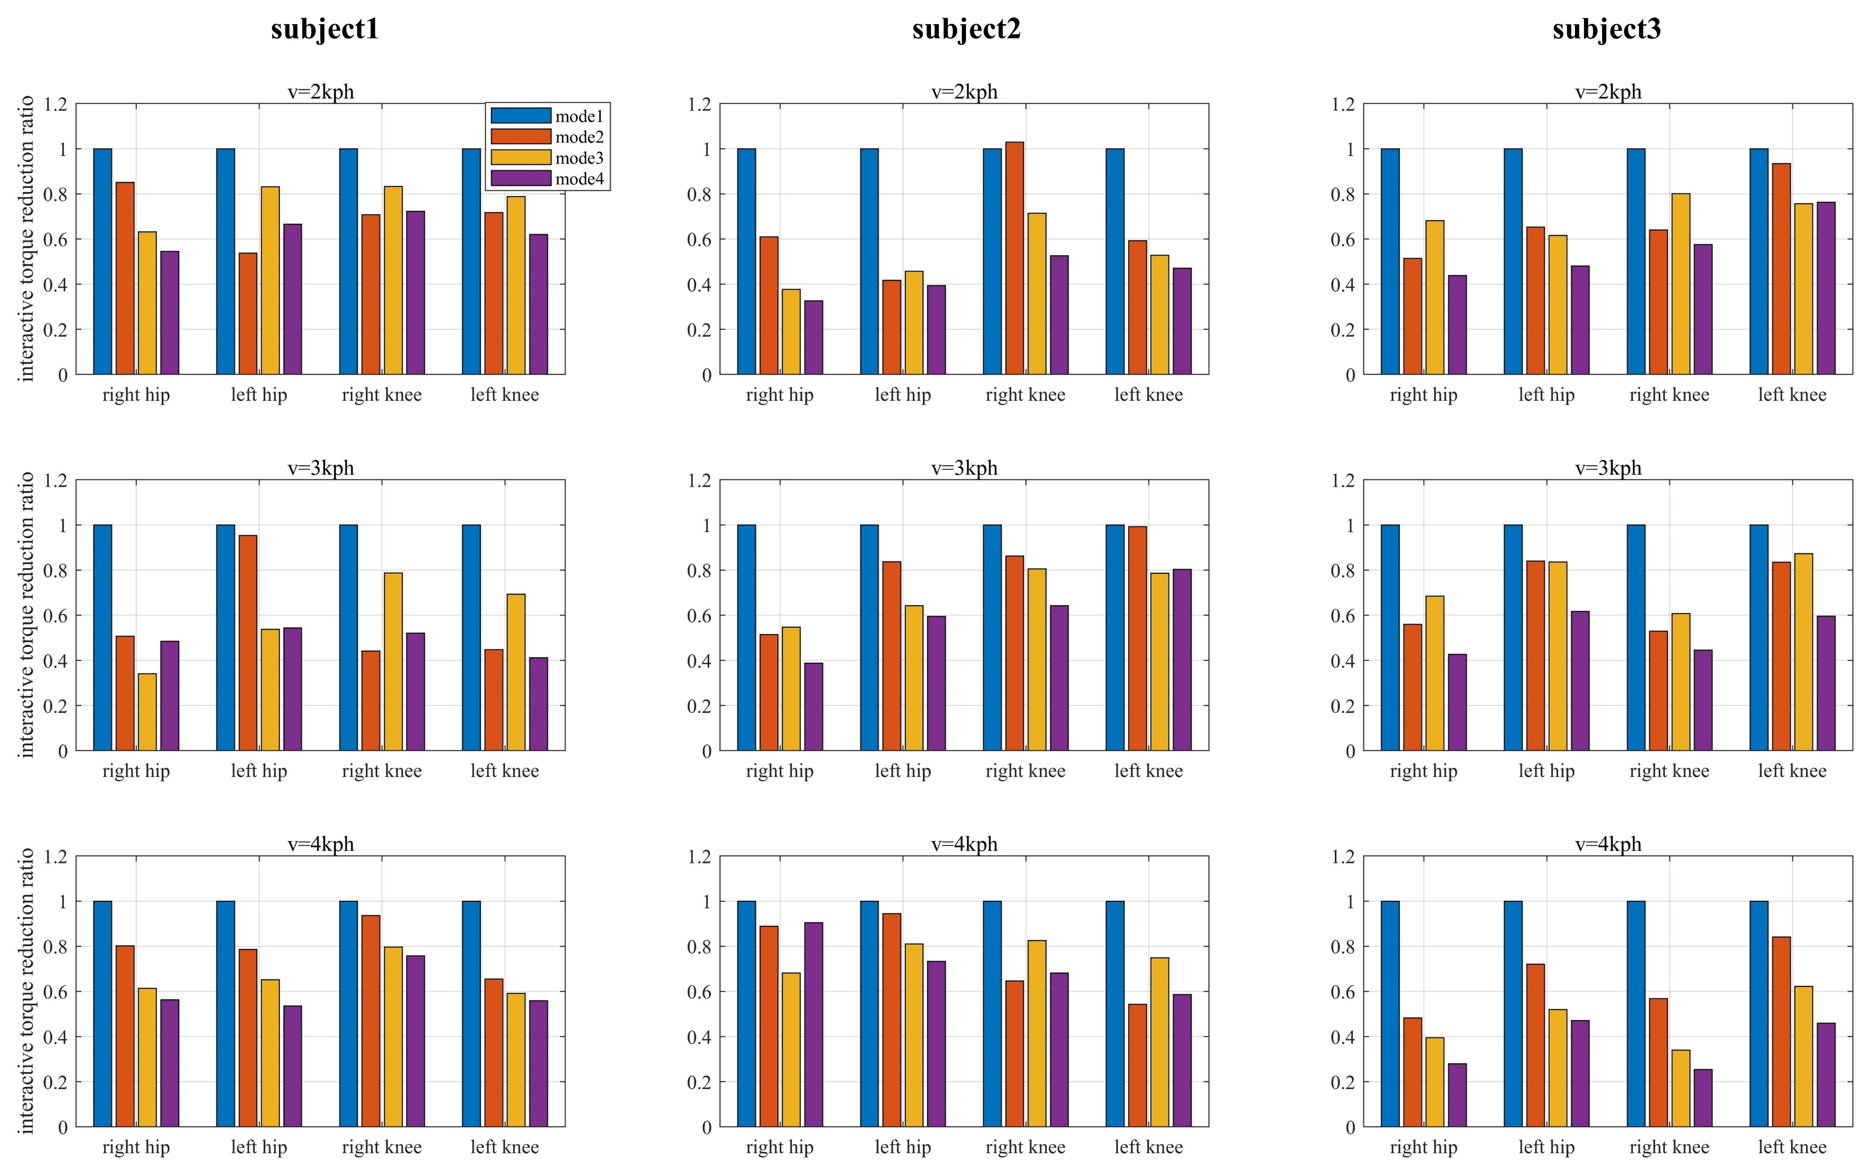
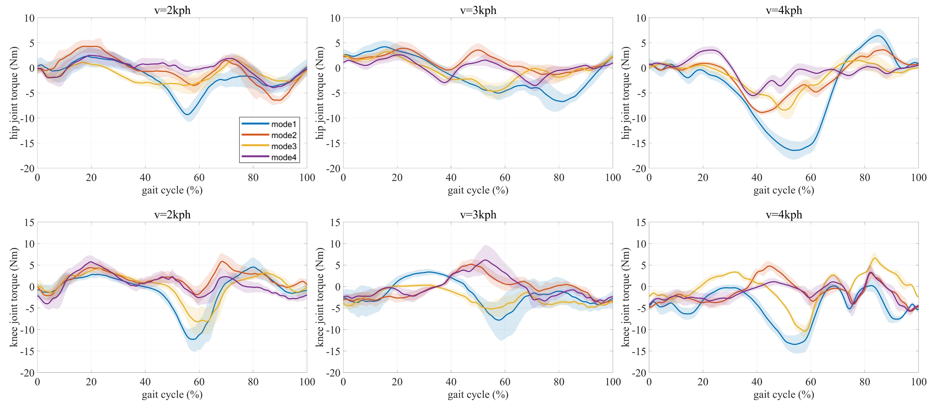
Research Experiences
Real-Time Control and Transparency Enhancement
Interaction torque reduction ratio
Hip and knee interaction torque of different walking speeds (per gait cycle)
fixed trajectory + fixed stiffness
variable trajectory + fixed stiffness
fixed trajectory + variable stiffness
Variable trajectory + variable stiffness
fixed trajectory + fixed stiffness
variable trajectory + fixed stiffness
fixed trajectory + variable stiffness
Variable trajectory + variable stiffness

Slide 10
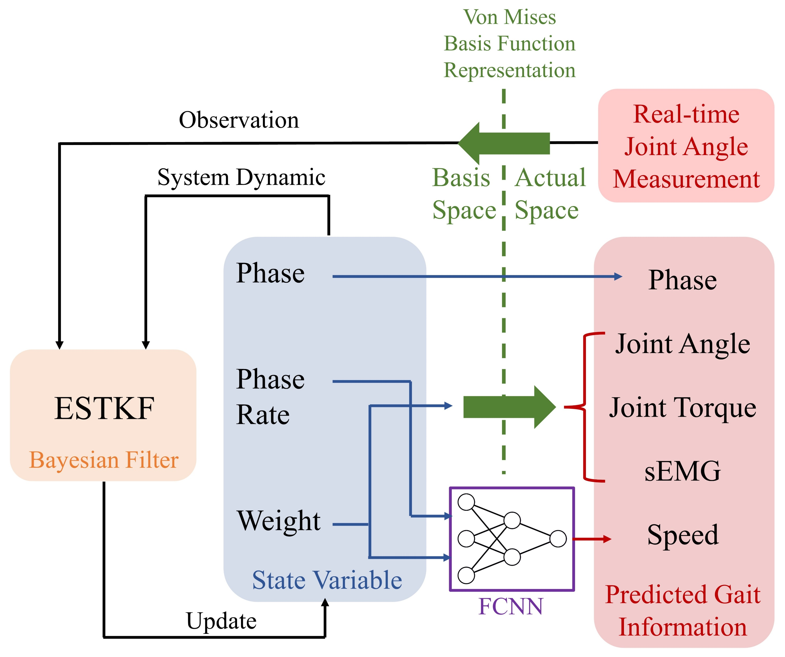
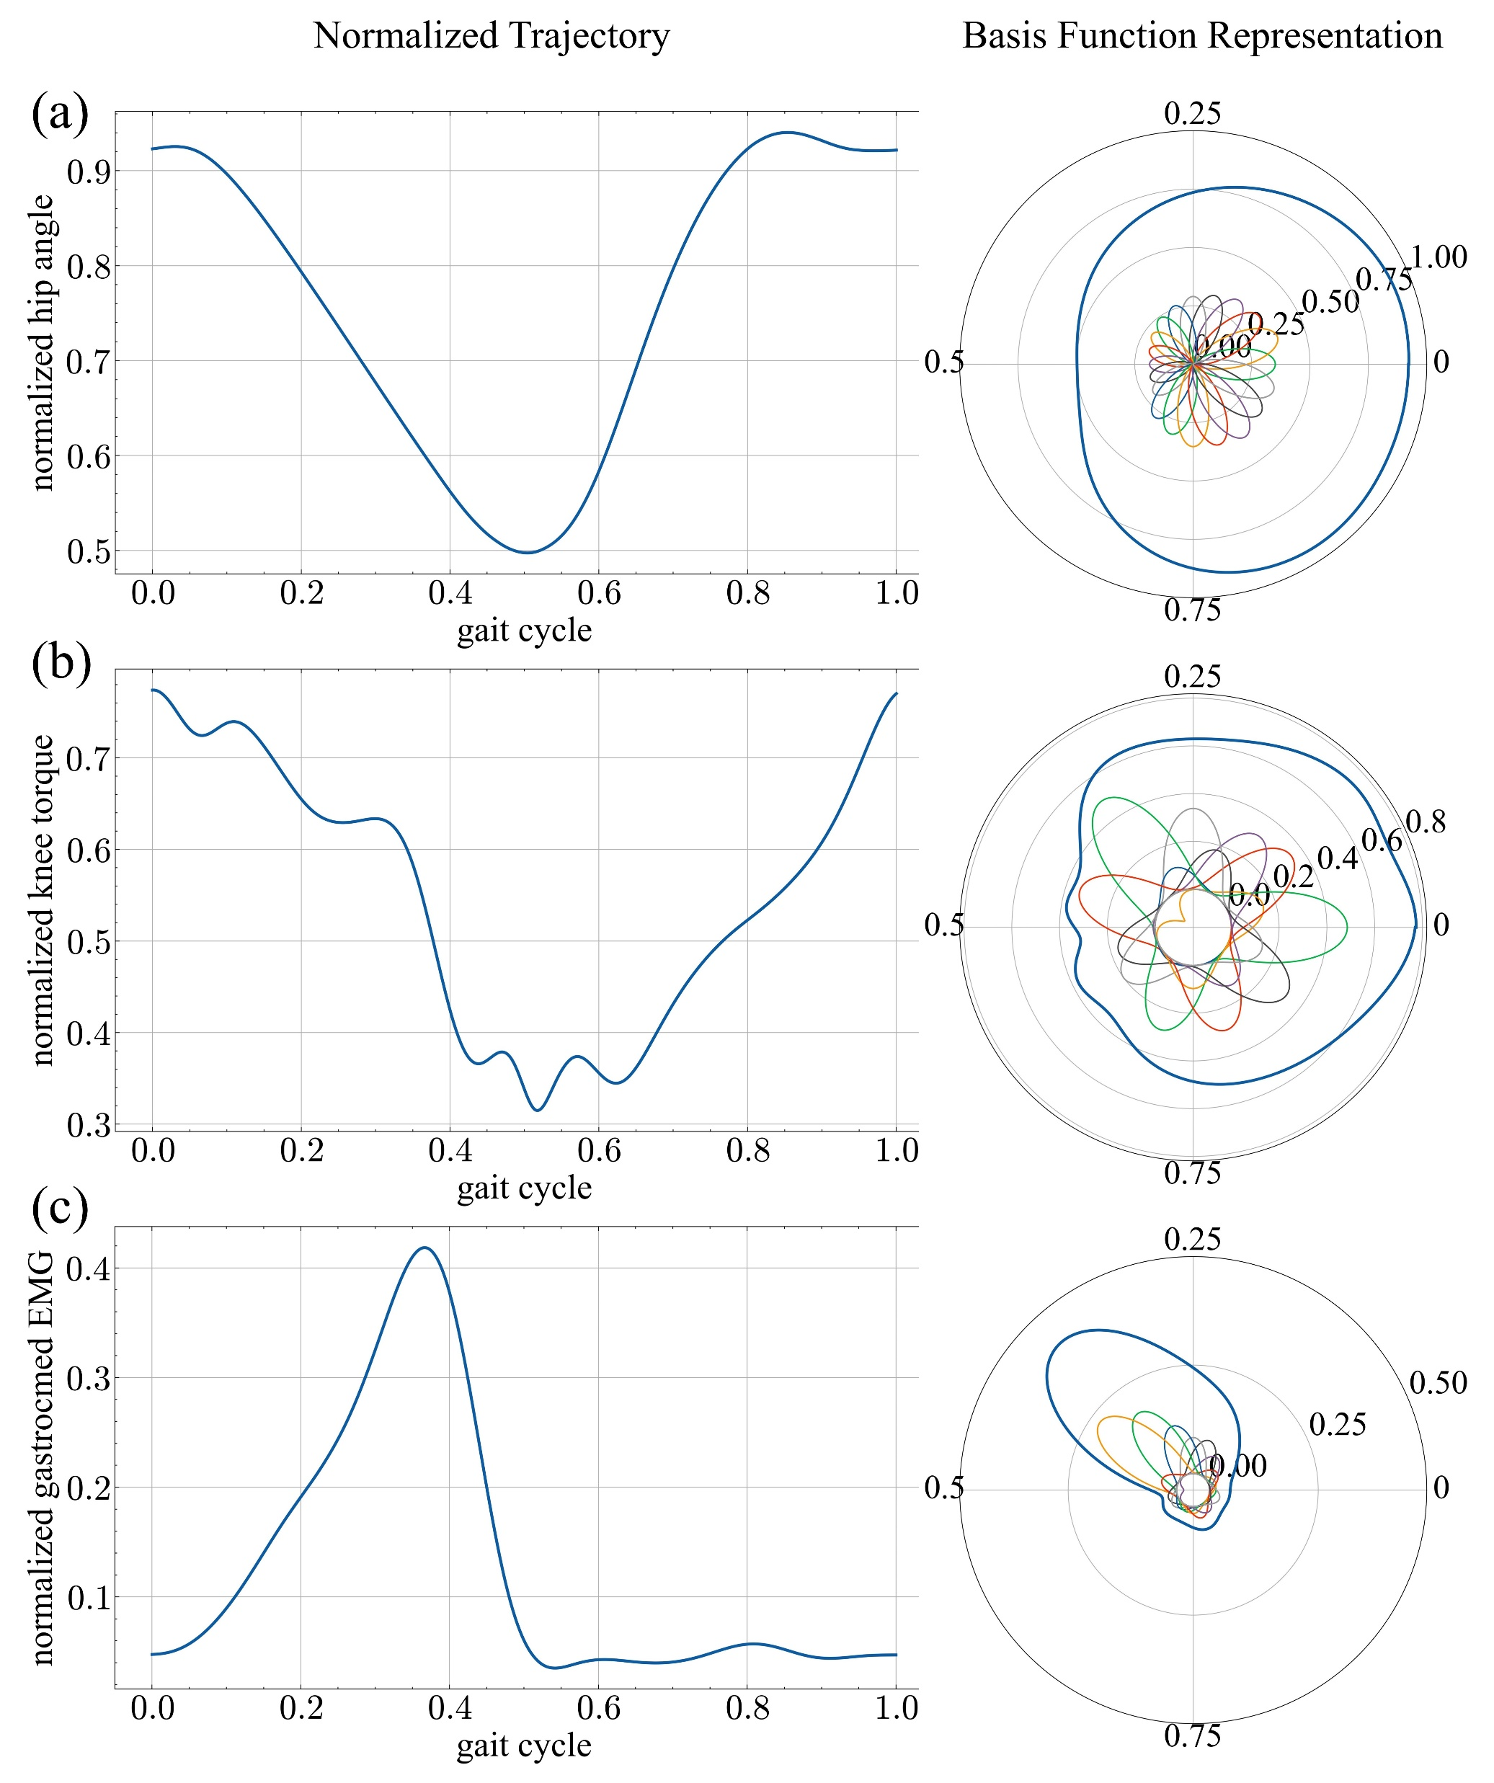
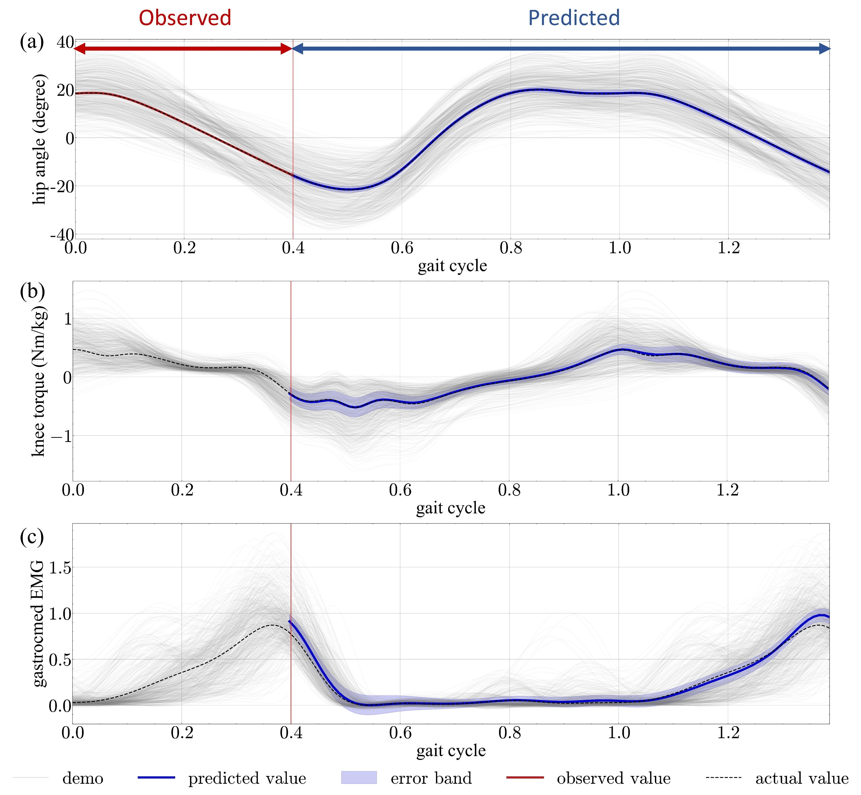
Research Experiences
Bayesian-inference based real time gait prediction
Normalized trajectories and their polar coordinate representation.
Gait information prediction
(phase, joint angle, joint torque, sEMG)

Slide 11
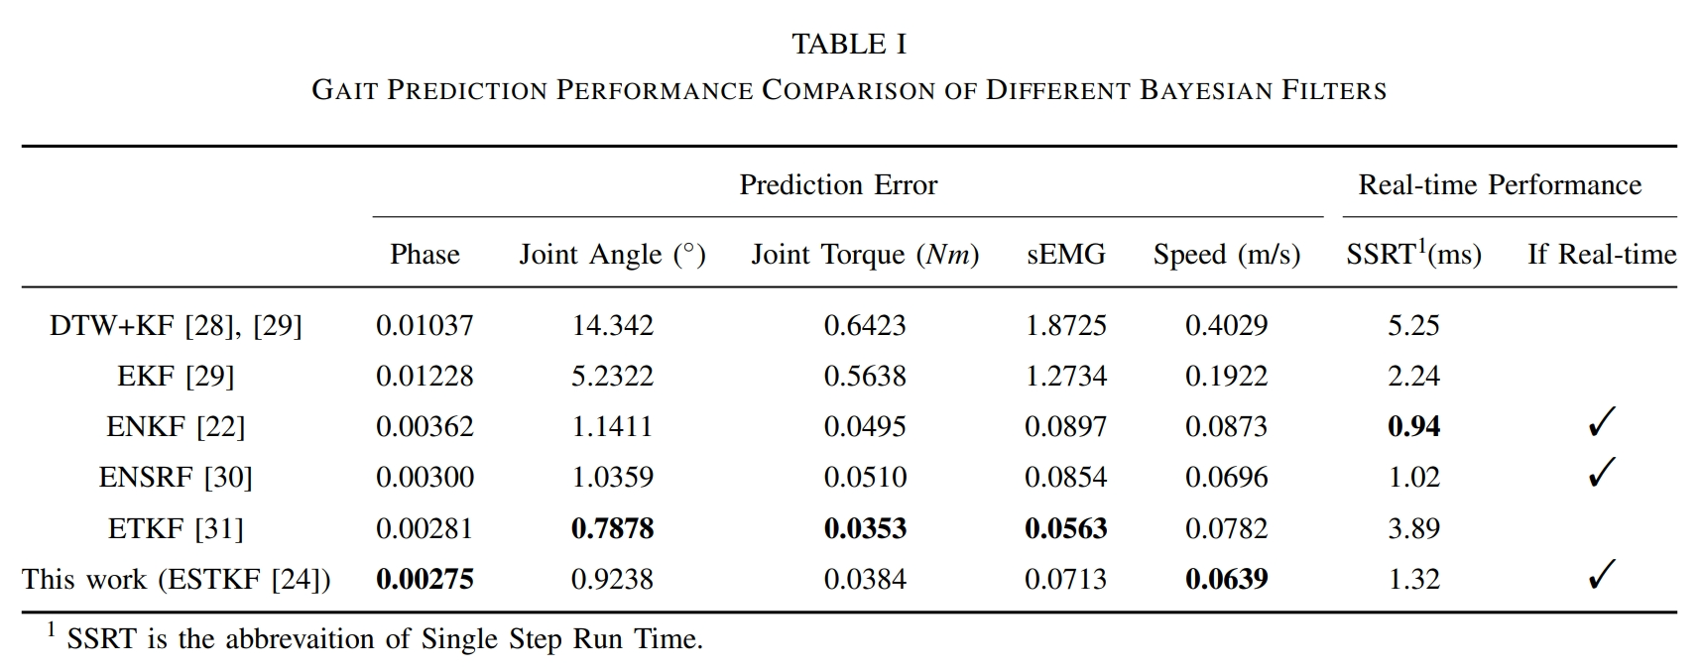
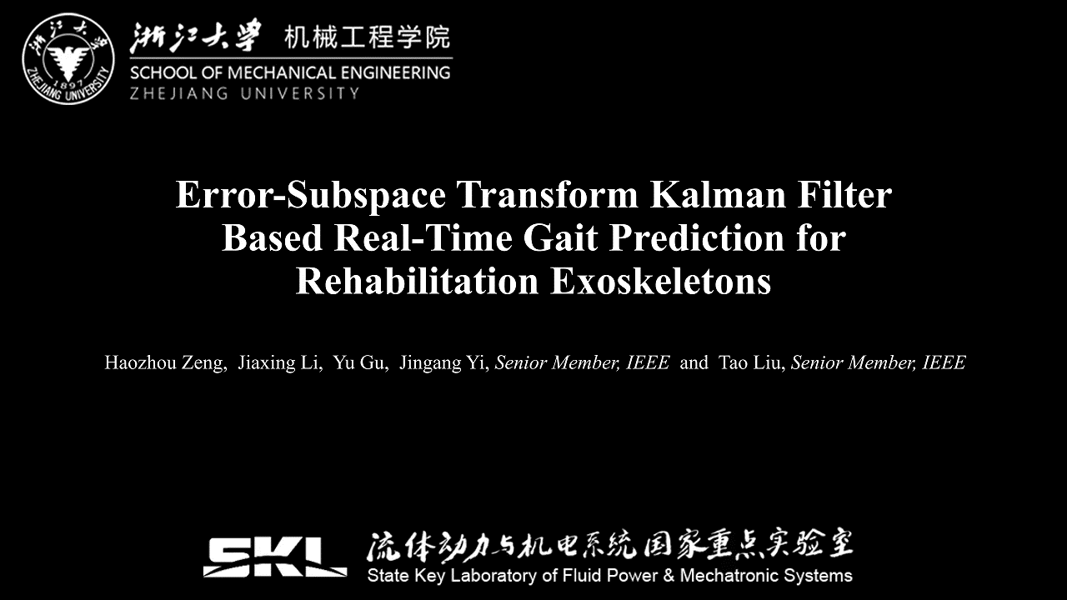
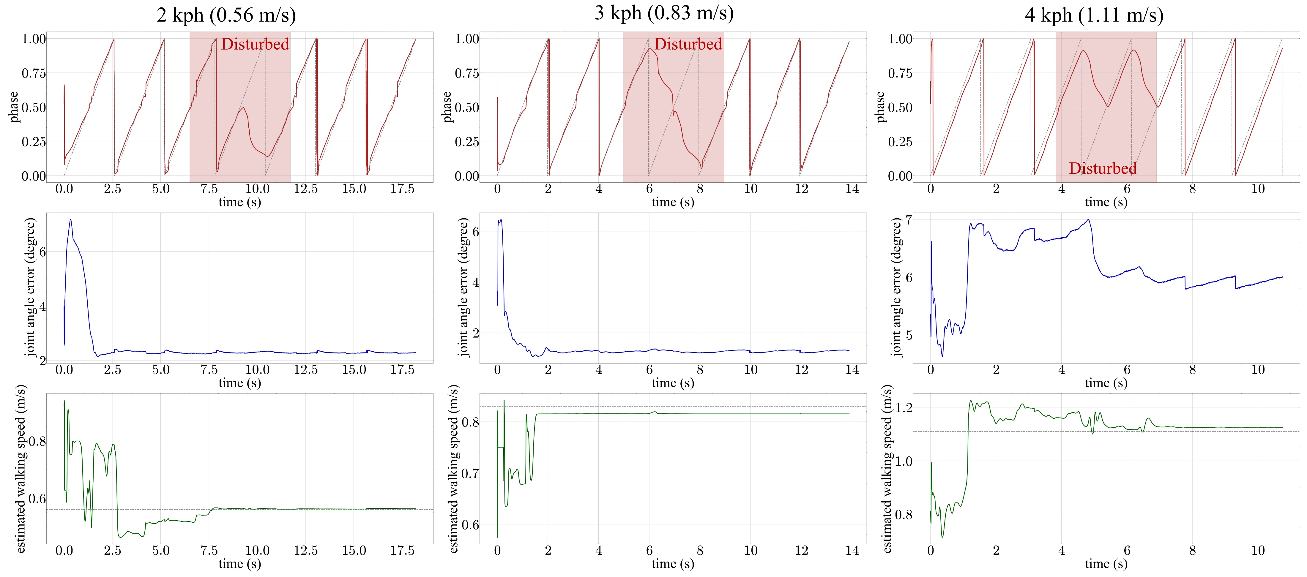
Research Experiences
Bayesian-inference based real time gait prediction
Real-time prediction performance at different walking speeds

Slide 12
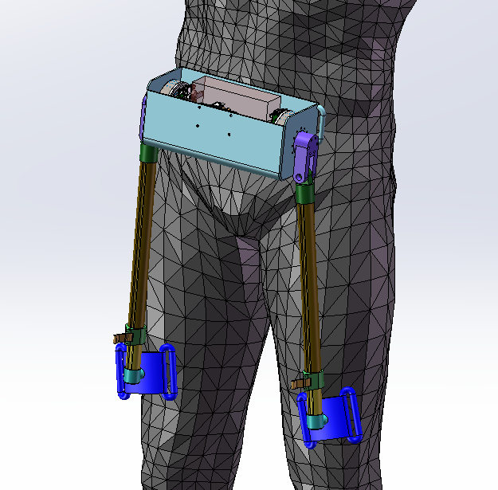
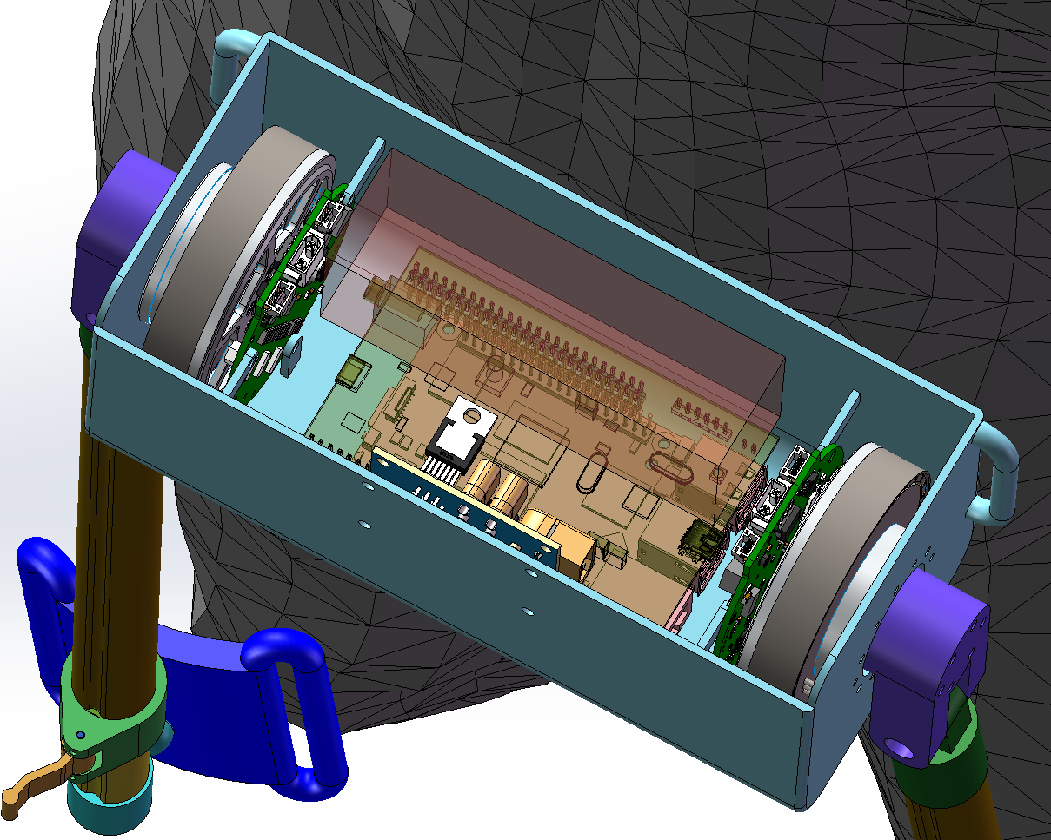
Research Experiences
Design of a hip exoskeleton (A collaborate project with CMU)
Raspberry Pi
STM32F4 Main Board
Motor Driver Board
Sensors (IMU…)

Slide 13
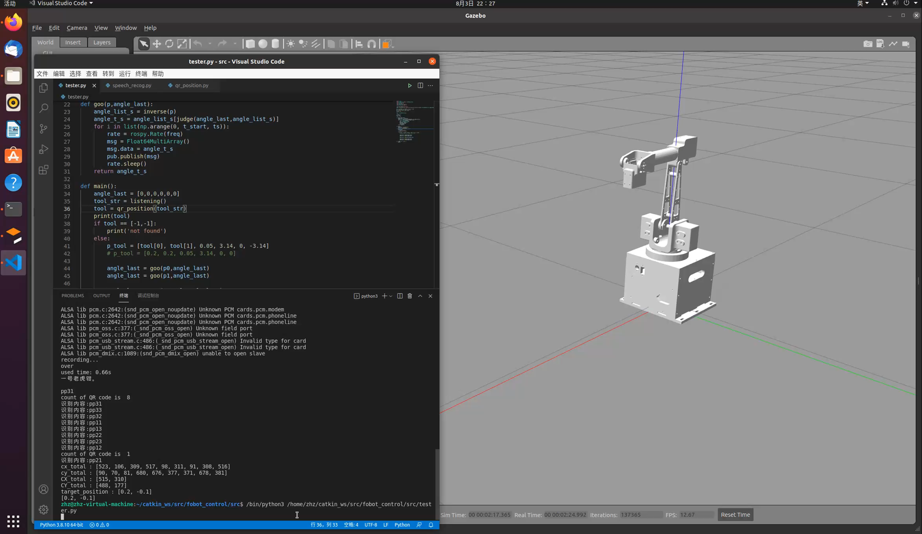
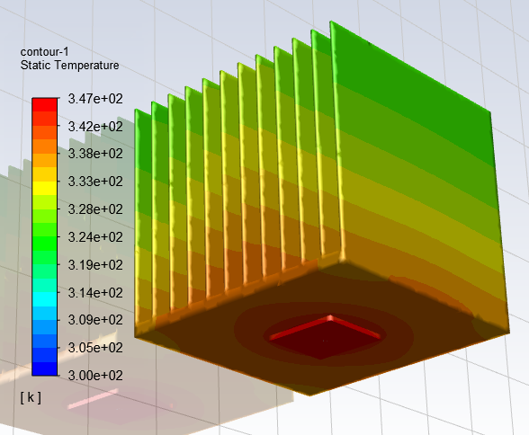
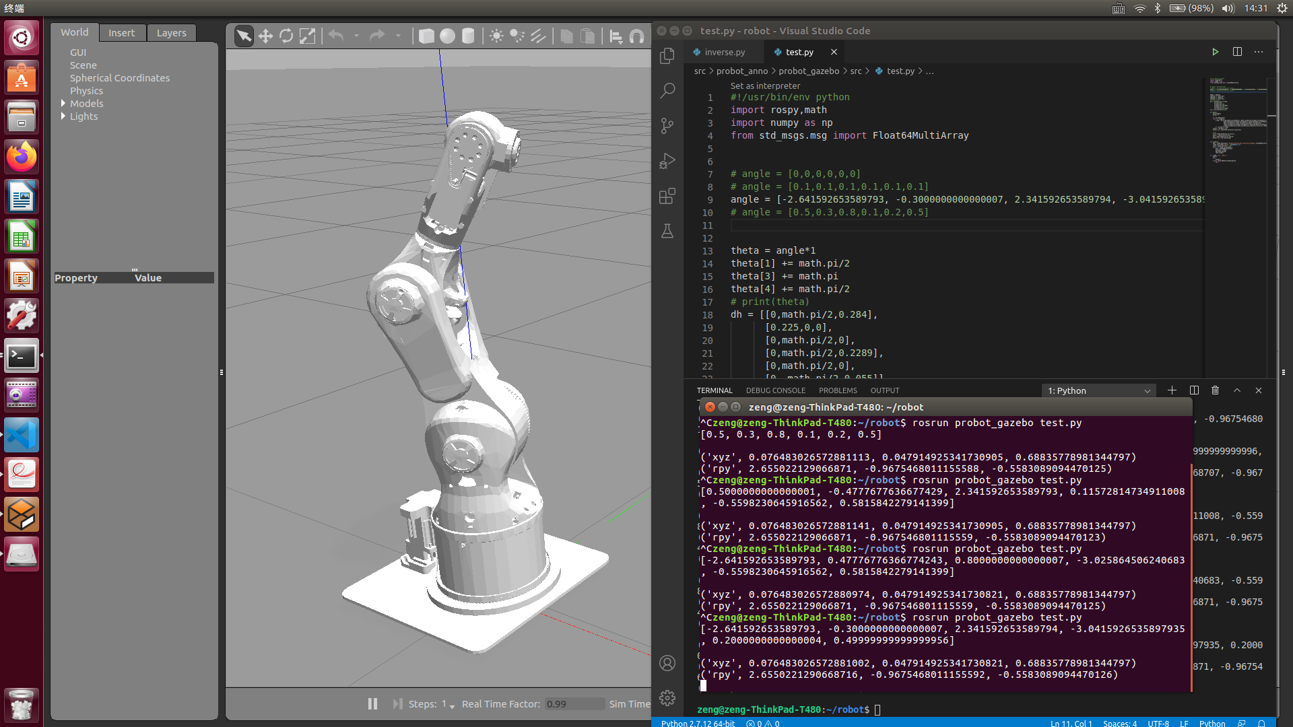
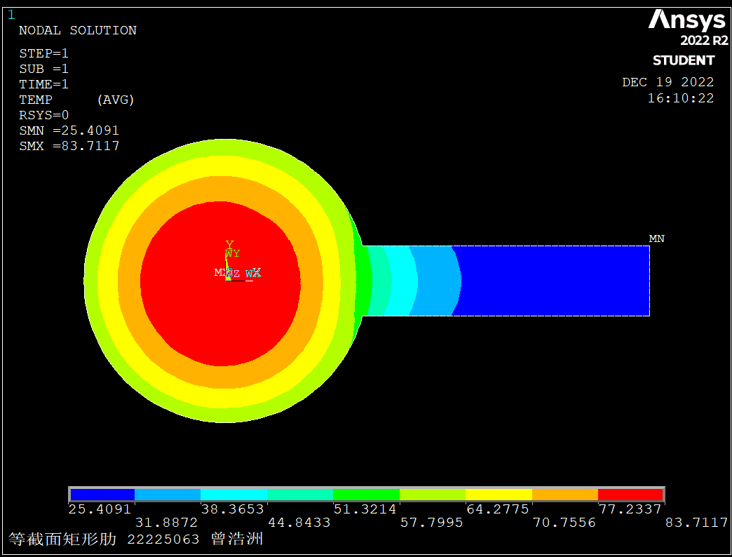
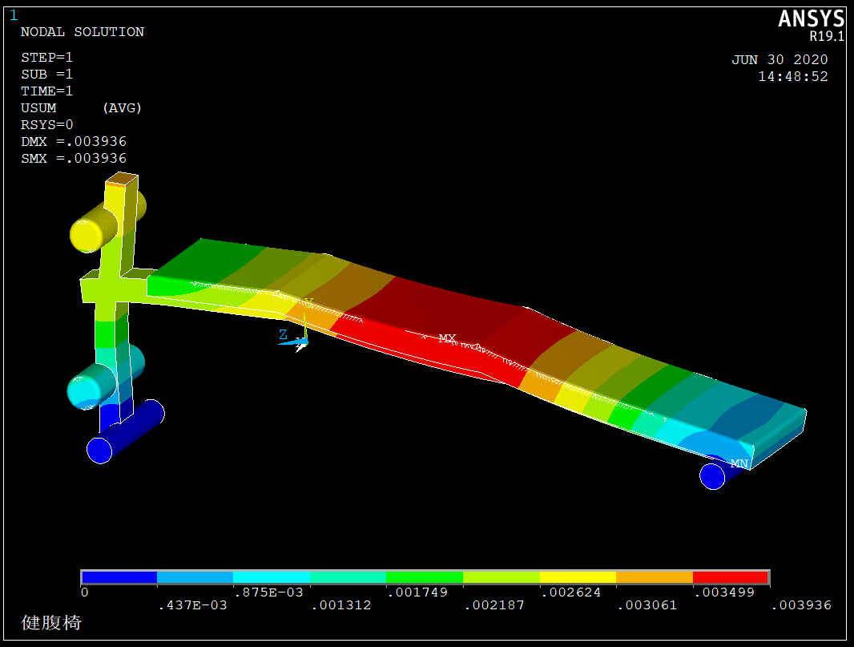
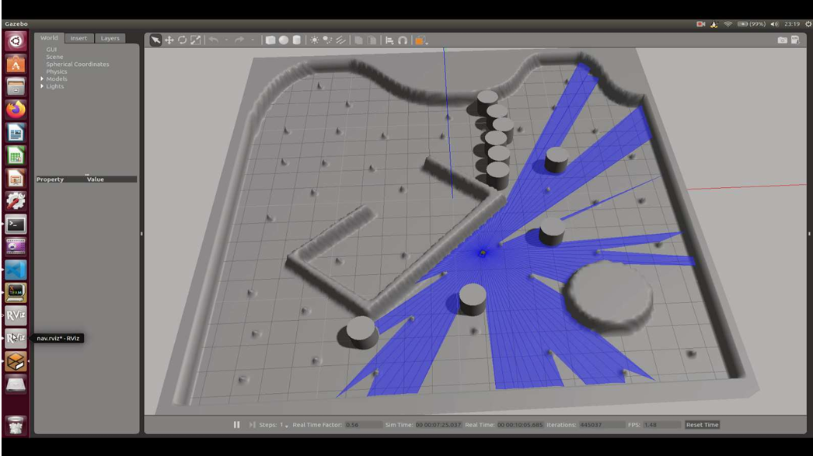
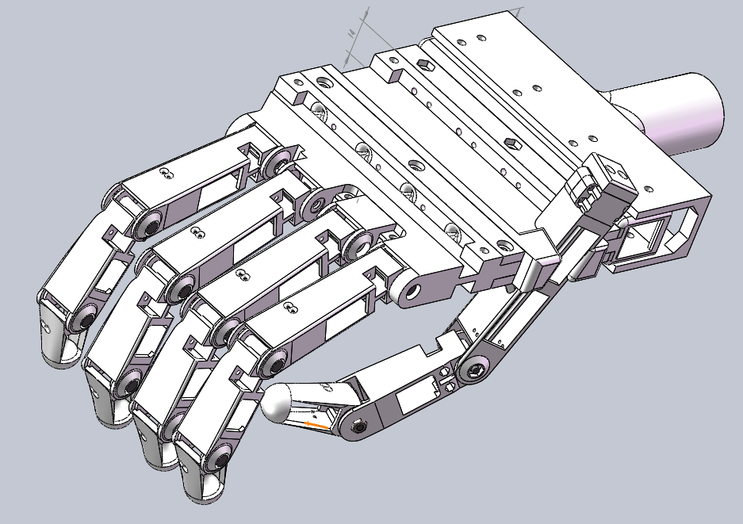
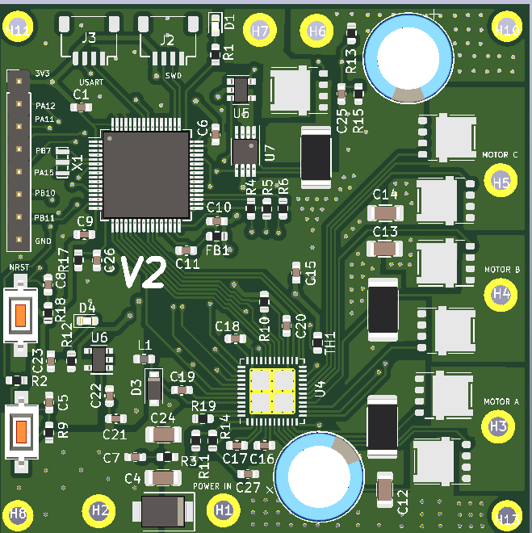
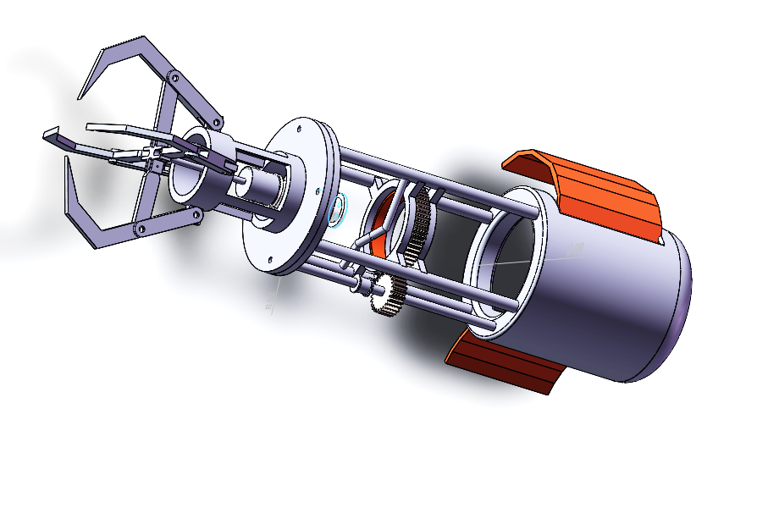
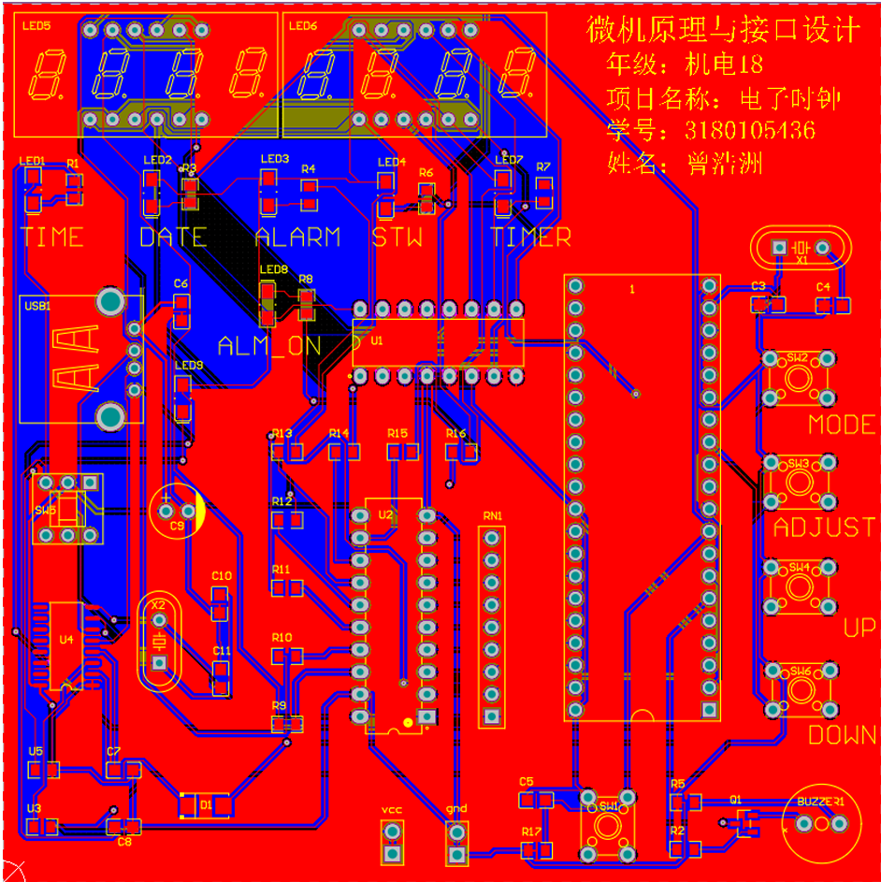
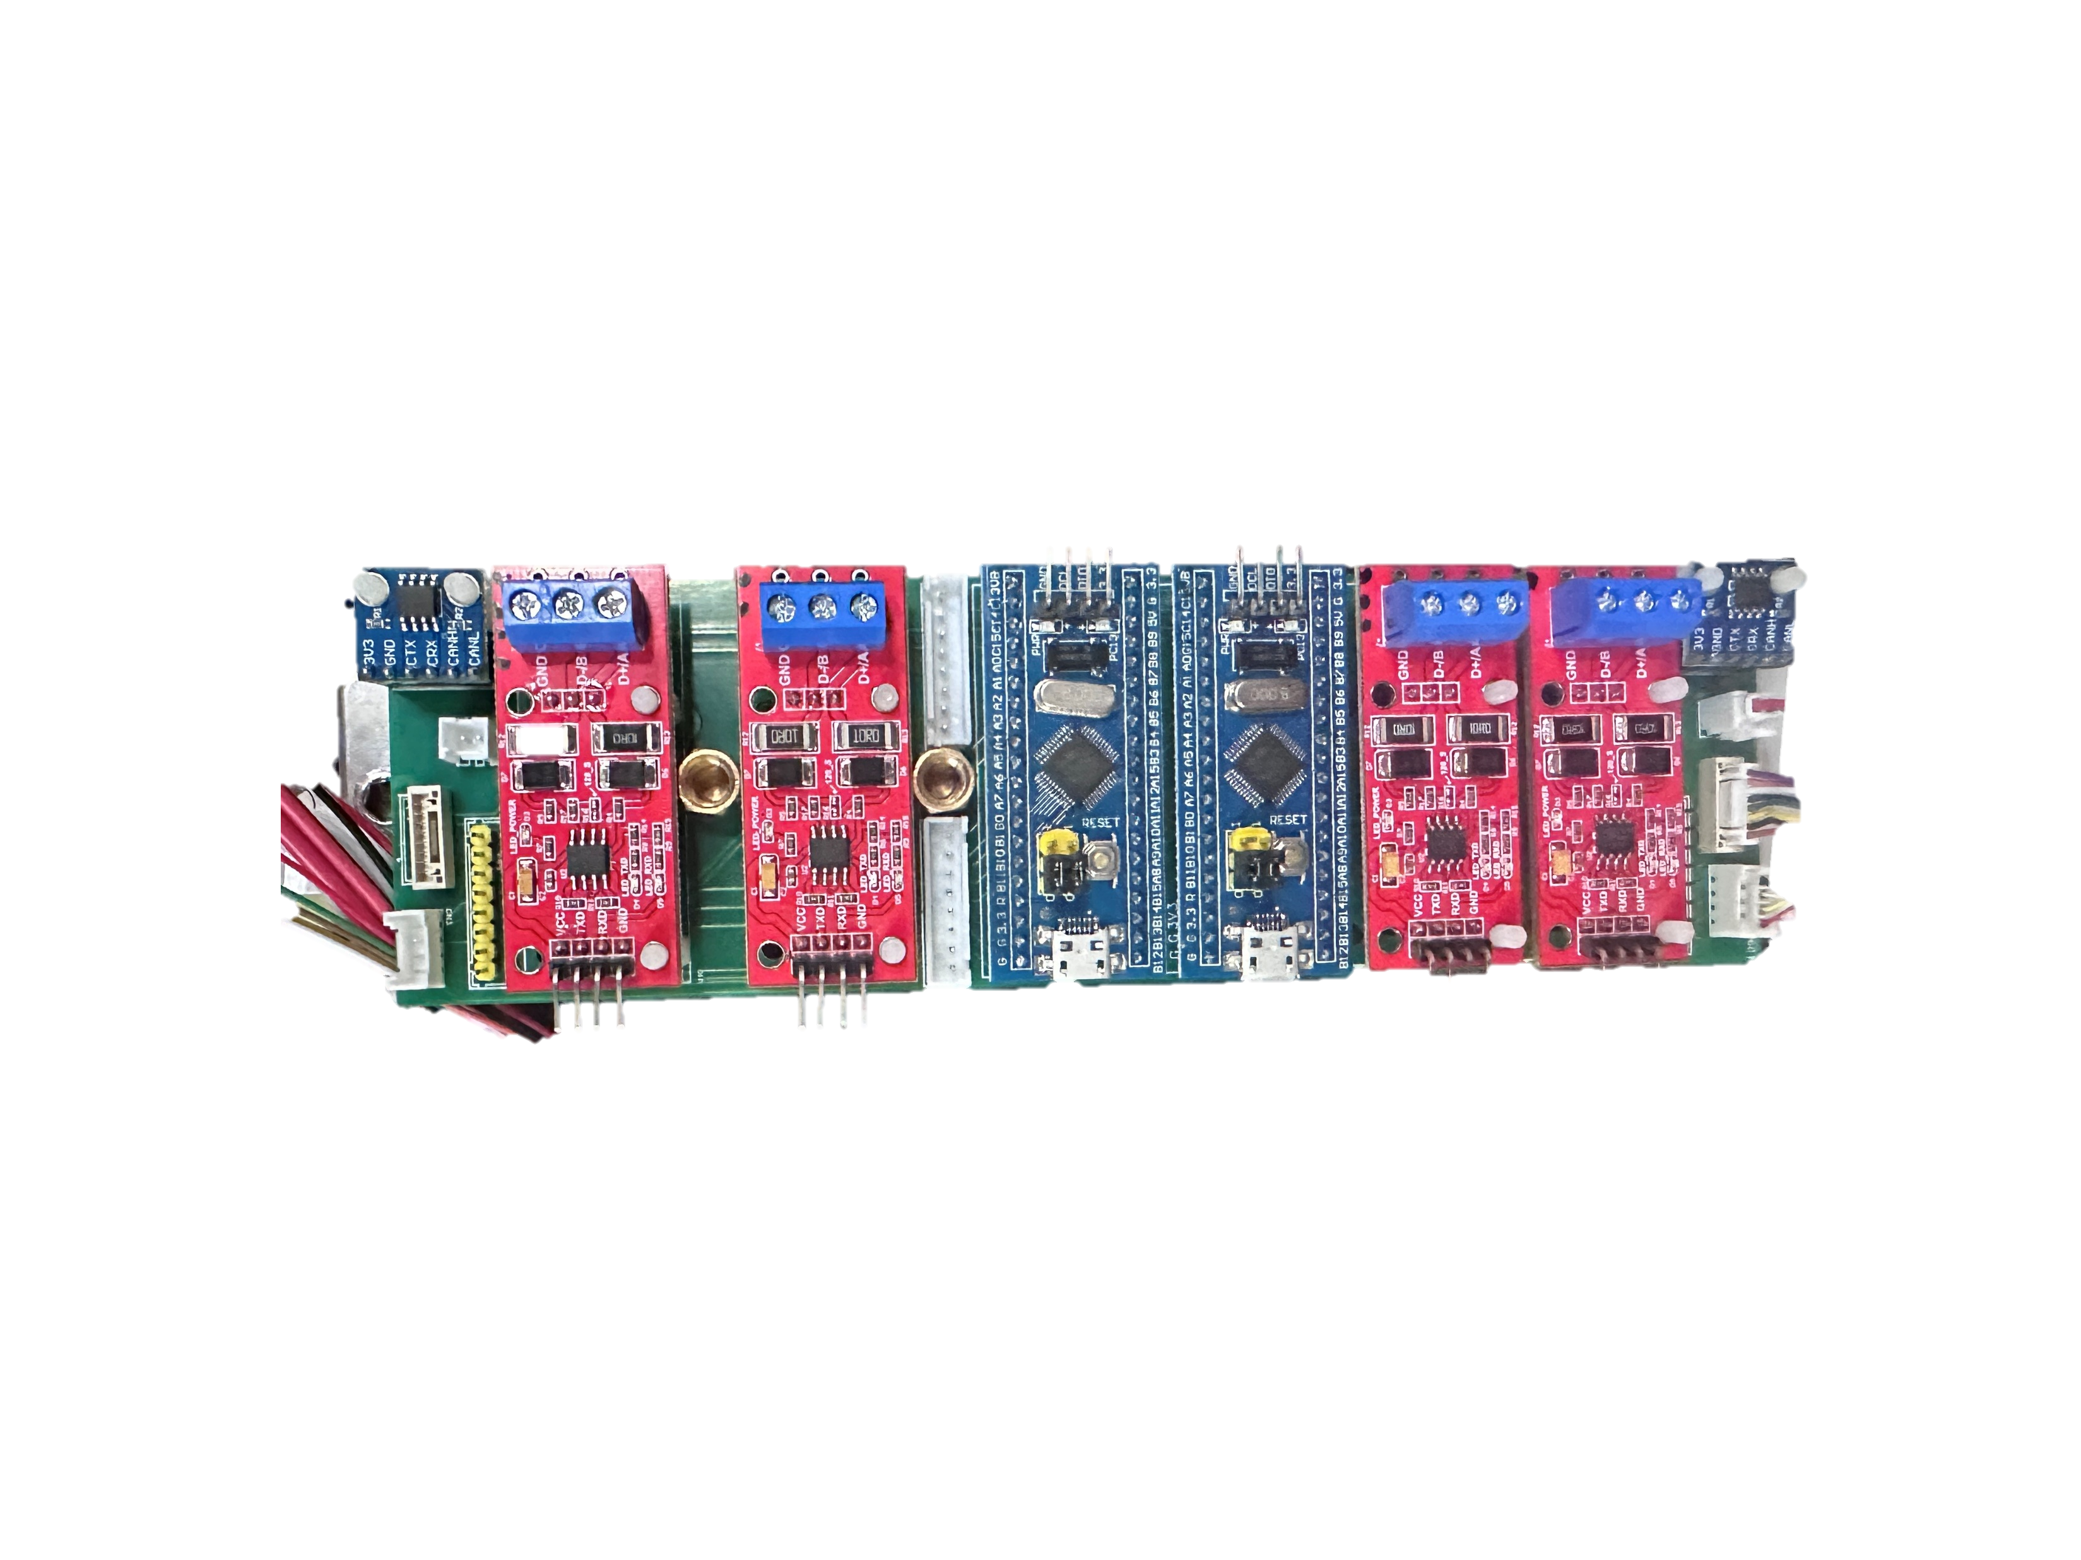
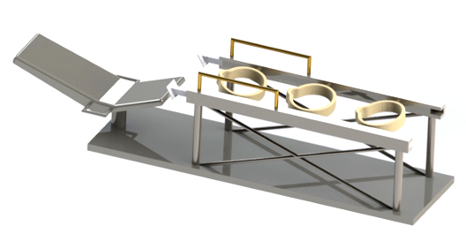
Other Experiences & Skills
Linux-based work environment (ROS)
Finite element analysis (Ansys)
Mechanical design (SolidWorks)
PCB design (AD, KiCAD…)

Slide 14
Thanks

Slide 16
Research Background

Slide 17
Research Proposal

